Slide 1


Image Enhancement by Histogram Processing
Kiran TALELE
 99 870 30 881

Slide 2
Kiran TALELE
@ Bharatiya Vidya Bhavans’ Sardar Patel Institute of Technology Andheri(w) Mumbai
Associate Professor, Electronics Engineering Department (1997)
Dean, Students, Alumni & External Relations (2022)
@ Sardar Patel Technology Business Incubator(SP-TBI),
Funded by Department of Science & Technology(DST),
Govt. of India
Head, Academic Relations (2015)
@ IEEE Bombay Section
Treasurer (2020)
Executive Committee Member (2015)
Kiran TALELE
‹#›

Slide 3
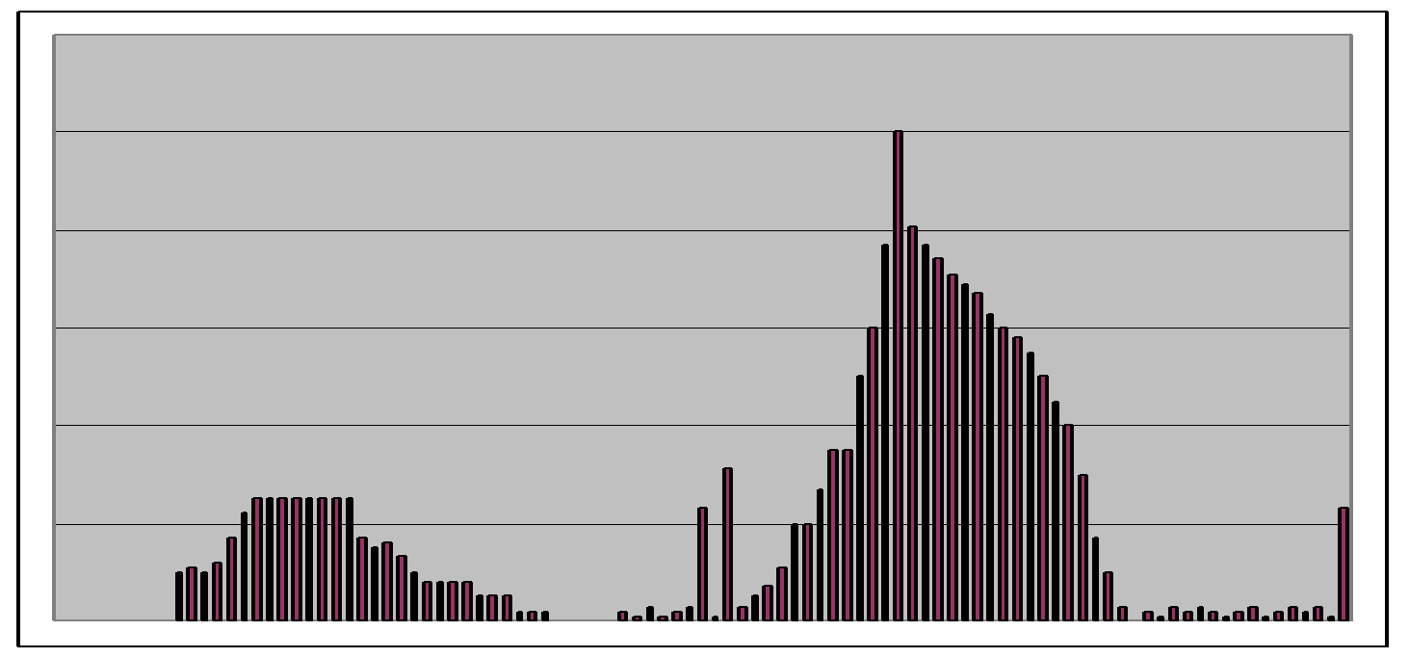
Image Histogram
The Histogram of an image is a Graph of Gray Value Vs Frequency of Gray Value in the image
It gives the distribution of grey levels in the image.
Histogram provides a global description of the appearance of an image. Information obtained from histogram is very large in quality.
Frequencies
Grey Levels

Slide 4
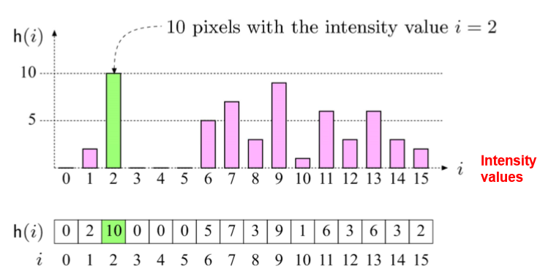
Image Histogram
Histograms: only statistical information
No indication of pixels locations

Slide 5
Image Histogram
10
9
7
6
6
5
3
3
3
2
2
1
0
0 0 0
Histograms: only statistical information
No indication of pixels locations

Slide 6
Image Histogram
10
9
7
6
6
5
3
3
3
2
2
1
0
0 0 0
Histograms: only statistical information
No indication of pixels locations

Slide 7
Image Contrast
The contrast of a Gray scale image indicates how easily objects in the image can be distinguished
High contrast image: many distinct intensity
values.
Low contrast: image uses few intensity
values.
Good Contrast?
Widely spread intensity values & large difference between min and max intensity values
Kiran TALELE
‹#›

Slide 8
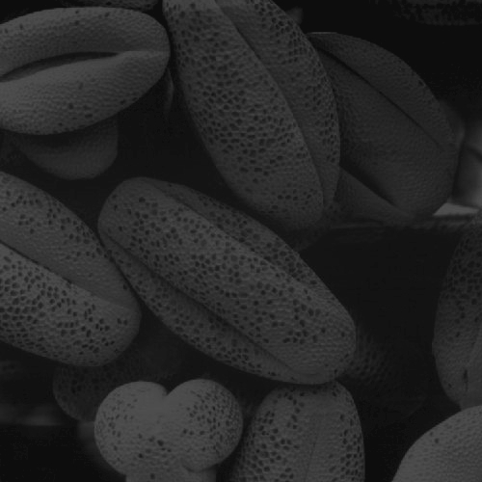
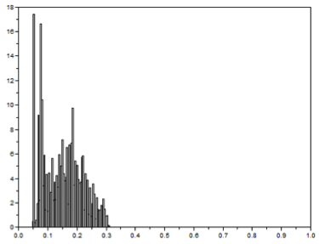
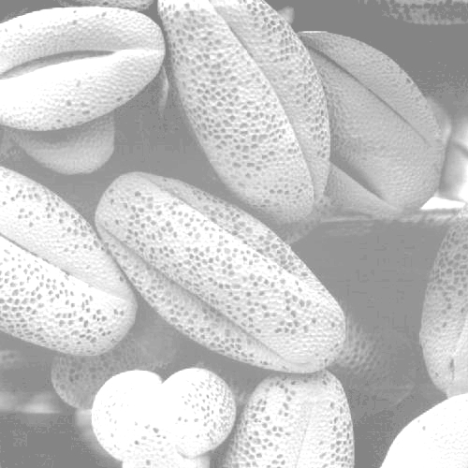
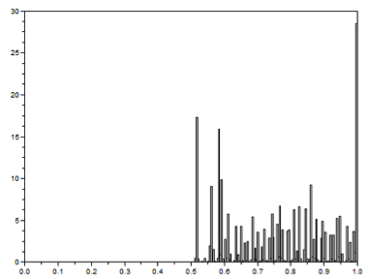
Dark Image
Low contrast
Bright Image
Low contrast

Slide 9

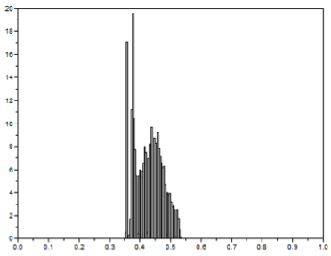
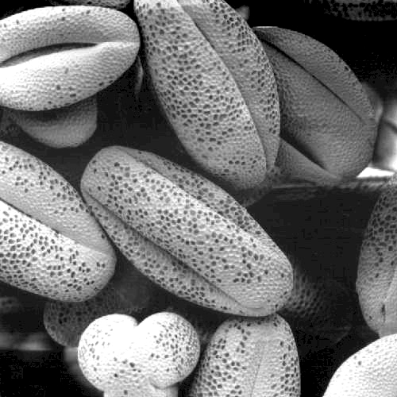
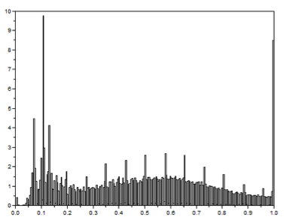
Low contrast
Poor Quality
Image
Wide contrast
Good Quality Image

Slide 10
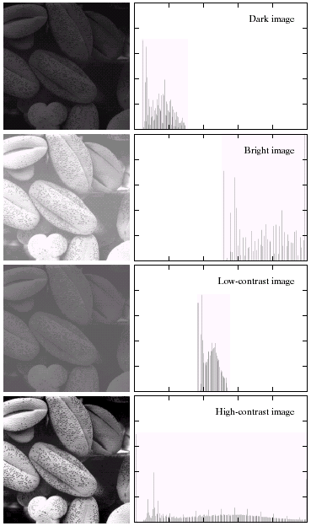
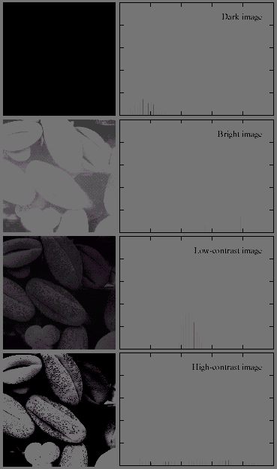
Dark Image
Low contrast
Bright Image
Low contrast
Low contrast
Poor Quality
Image
Wide contrast
Good Quality Image

Slide 11
Image Enhancement by Histogram Processing :
(i) Histogram of dark image, bright image and low contrast image is narrow
(ii) This can be done by adjusting the Probability Density Function (PDF) of the original Histogram of the image so that the Probability spreads equally
‹#›
Kiran TALELE 99870 30 881 talelesir@gmail.com

Slide 12
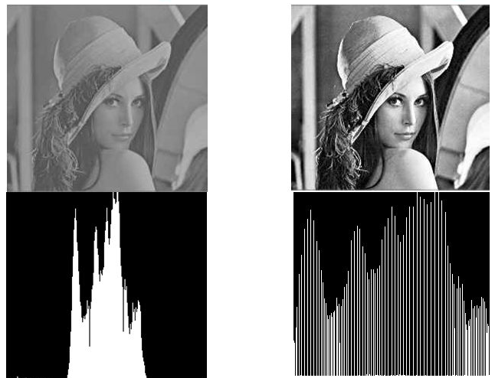
Example :
Kiran TALELE
‹#›

Slide 13
(iii) Histogram Processing involves the modification of input image histogram to increase the dynamic range of gray values
(iv) This improves the visual quality of image on display device
‹#›
Kiran TALELE 99870 30 881 talelesir@gmail.com

Slide 14
[1] Histogram Equalization
(i) Histogram Equalization Tx increases dynamic range of gray levels of input image so that they are evenly distributed.
The histogram of the output image is almost uniform over the entire range of gray levels.
(iii) In Histogram Equalization, output image is obtained by mapping each pixel with value rk in the input image into a corresponding pixel with value Sk in the output image.
‹#›
Kiran TALELE 99870 30 881 talelesir@gmail.com

Slide 15
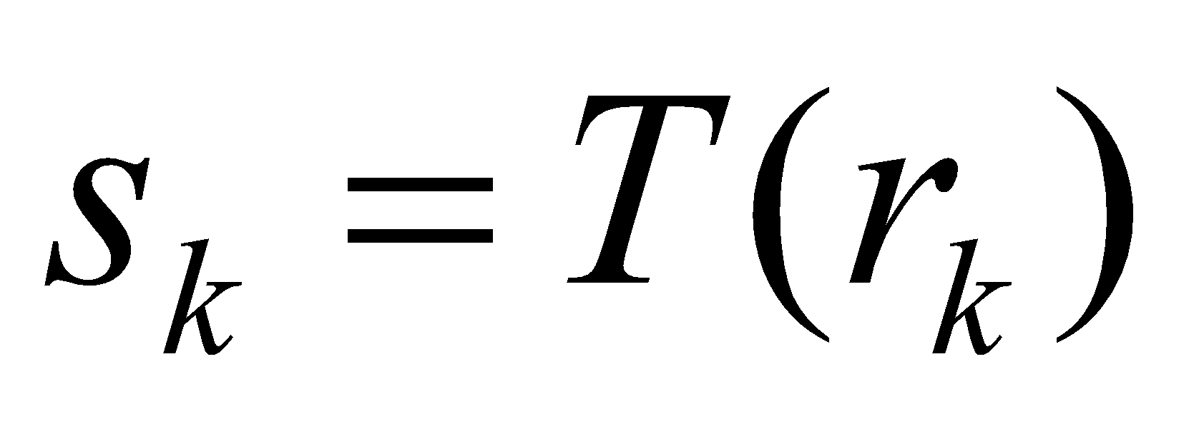
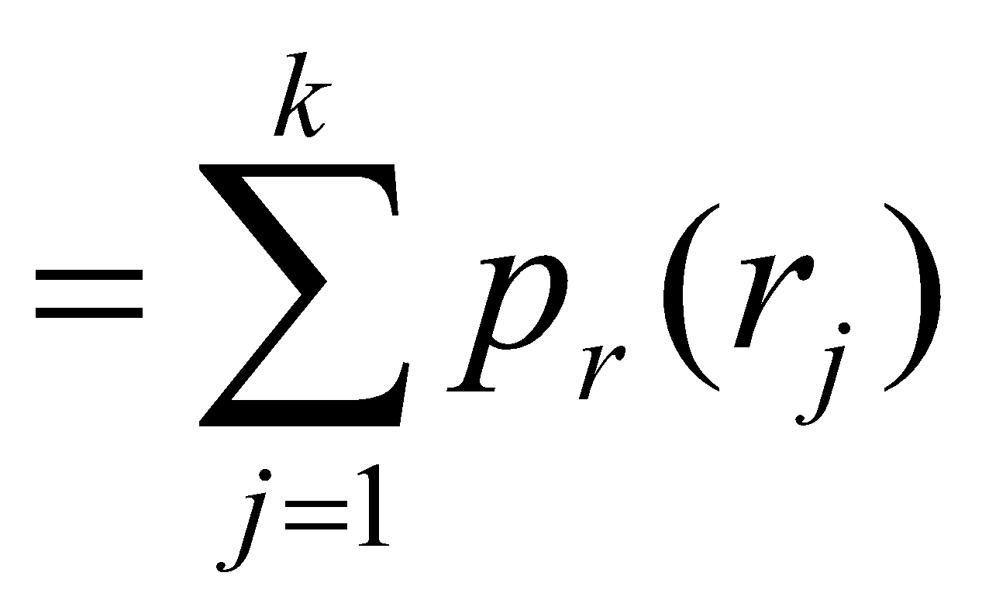
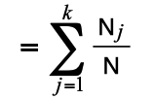
Histogram Equalisation
The formula for histogram equalisation is given where
r_{k}: input intensity
s_{k}: processed intensity
k: the intensity range (e.g 0.0 – 1.0)
N_{j}: the frequency of intensity j
N: the sum of all frequencies
‹#›
Kiran TALELE 99870 30 881 talelesir@gmail.com

Slide 16
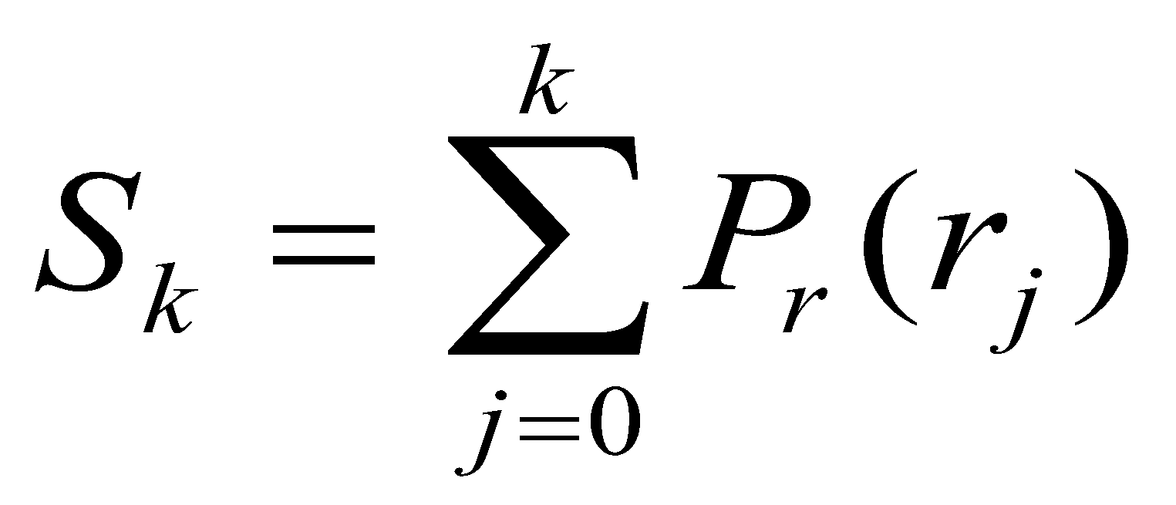
Q1 Given input image F, Apply Histogram Equalization Tx and obtain new image
F(x,y) = | x – y | for x,y = 0,1,2,3,4,5,6,7
HE Tx is defined as,
‹#›
Kiran TALELE 99870 30 881 talelesir@gmail.com

Slide 17
F(x,y) = | x – y | for x,y = 0,1,2,3,4,5,6,7
Y
0 1 2 3 4 5 6 7
X
0
1
2
3
4
5
6
7
‹#›
Kiran TALELE 99870 30 881 talelesir@gmail.com

Slide 18
F(x,y) = | x – y | for x,y = 0,1,2,3,4,5,6,7
Y
0 1 2 3 4 5 6 7
X
0
1
2
3
4
5
6
7
0 | 1 | 2 | 3 | 4 | 5 | 6 | 7
‹#›
Kiran TALELE 99870 30 881 talelesir@gmail.com

Slide 19
F(x,y) = | x – y | for x,y = 0,1,2,3,4,5,6,7
Y
0 1 2 3 4 5 6 7
X
0
1
2
3
4
5
6
7
0 | 1 | 2 | 3 | 4 | 5 | 6 | 7
1 | 0 | 1 | 2 | 3 | 4 | 5 | 6
‹#›
Kiran TALELE 99870 30 881 talelesir@gmail.com

Slide 20
F(x,y) = | x – y | for x,y = 0,1,2,3,4,5,6,7
Y
0 1 2 3 4 5 6 7
X
0
1
2
3
4
5
6
7
0 | 1 | 2 | 3 | 4 | 5 | 6 | 7
1 | 0 | 1 | 2 | 3 | 4 | 5 | 6
2 | 1 | 0 | 1 | 2 | 3 | 4 | 5
3 | 2 | 1 | 0 | 1 | 2 | 3 | 4
4 | 3 | 2 | 1 | 0 | 1 | 2 | 3
5 | 4 | 3 | 2 | 1 | 0 | 1 | 2
6 | 5 | 4 | 3 | 2 | 1 | 0 | 1
7 | 6 | 5 | 4 | 3 | 2 | 1 | 0
‹#›
Kiran TALELE 99870 30 881 talelesir@gmail.com

Slide 21
F(x,y) = | x – y | for x,y = 0,1,2,3,4,5,6,7
Y
0 1 2 3 4 5 6 7
X
0
1
2
3
4
5
6
7
0 | 1 | 2 | 3 | 4 | 5 | 6 | 7
1 | 0 | 1 | 2 | 3 | 4 | 5 | 6
2 | 1 | 0 | 1 | 2 | 3 | 4 | 5
3 | 2 | 1 | 0 | 1 | 2 | 3 | 4
4 | 3 | 2 | 1 | 0 | 1 | 2 | 3
5 | 4 | 3 | 2 | 1 | 0 | 1 | 2
6 | 5 | 4 | 3 | 2 | 1 | 0 | 1
7 | 6 | 5 | 4 | 3 | 2 | 1 | 0
‹#›
Kiran TALELE 99870 30 881 talelesir@gmail.com

Slide 22
Input Image
Frequency Table
INPUT r_{k} | Freq. Nr_{k}
0 | 8
1 | 14
2 | 12
3 | 10
4 | 8
5 | 6
6 | 4
7 | 2
0 | 1 | 2 | 3 | 4 | 5 | 6 | 7
1 | 0 | 1 | 2 | 3 | 4 | 5 | 6
2 | 1 | 0 | 1 | 2 | 3 | 4 | 5
3 | 2 | 1 | 0 | 1 | 2 | 3 | 4
4 | 3 | 2 | 1 | 0 | 1 | 2 | 3
5 | 4 | 3 | 2 | 1 | 0 | 1 | 2
6 | 5 | 4 | 3 | 2 | 1 | 0 | 1
7 | 6 | 5 | 4 | 3 | 2 | 1 | 0
‹#›
Kiran TALELE 99870 30 881 talelesir@gmail.com

Slide 23
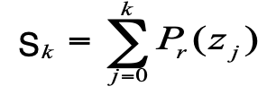
Step-1 : Equalize Histogram
r_{k}
s_{k}
Histogram Eualization S_{k} = T (r_{k})
Kiran TALELE 99870 30 881 talelesir@gmail.com

Slide 24
INPUT rk | Norm rk | Freq. Nr_{k} | PDF Pr | CDF S_{k} | Equalized Gray Value S_{k}
0
1
2
3
4
5
6
7
Kiran TALELE 99870 30 881 talelesir@gmail.com

Slide 25
INPUT rk | Norm rk | Freq. Nr_{k} | PDF Pr | CDF S_{k} | Equalized Gray Value S_{k}
0 |  | 8
1 |  | 14
2 |  | 12
3 |  | 10
4 |  | 8
5 |  | 6
6 |  | 4
7 |  | 2
Kiran TALELE 99870 30 881 talelesir@gmail.com

Slide 26
INPUT rk | Norm rk | Freq. Nr_{k} | PDF Pr | CDF S_{k} | Equalized Gray Value S_{k}
0 |  | 8 | 0.125
1 |  | 14 | 0.219
2 |  | 12 | 0.187
3 |  | 10 | 0.156
4 |  | 8 | 0.125
5 |  | 6 | 0.094
6 |  | 4 | 0.063
7 |  | 2 | 0.031
Kiran TALELE 99870 30 881 talelesir@gmail.com

Slide 27
INPUT rk | Norm rk | Freq. Nr_{k} | PDF Pr | CDF S_{k} | Equalized Gray Value S_{k}
0 |  | 8 | 0.125 | 0.125
1 |  | 14 | 0.219
2 |  | 12 | 0.187
3 |  | 10 | 0.156
4 |  | 8 | 0.125
5 |  | 6 | 0.094
6 |  | 4 | 0.063
7 |  | 2 | 0.031
Kiran TALELE 99870 30 881 talelesir@gmail.com

Slide 28
INPUT rk | Norm rk | Freq. Nr_{k} | PDF Pr | CDF S_{k} | Equalized Gray Value S_{k}
0 |  | 8 | 0.125 | 0.125
1 |  | 14 | 0.219 | 0.344
2 |  | 12 | 0.187
3 |  | 10 | 0.156
4 |  | 8 | 0.125
5 |  | 6 | 0.094
6 |  | 4 | 0.063
7 |  | 2 | 0.031
INPUT rk | Norm rk | Freq. Nr_{k} | PDF Pr | CDF S_{k} | Equalized Gray Value S_{k}
0 |  | 8 | 0.125 | 0.125
1 |  | 14 | 0.219
2 |  | 12 | 0.187
3 |  | 10 | 0.156
4 |  | 8 | 0.125
5 |  | 6 | 0.094
6 |  | 4 | 0.063
7 |  | 2 | 0.031
Kiran TALELE 99870 30 881 talelesir@gmail.com

Slide 29
INPUT rk | Norm rk | Freq. Nr_{k} | PDF Pr | CDF S_{k} | Equalized Gray Value S_{k}
0 |  | 8 | 0.125 | 0.125
1 |  | 14 | 0.219 | 0.344
2 |  | 12 | 0.187 | 0.531
3 |  | 10 | 0.156
4 |  | 8 | 0.125
5 |  | 6 | 0.094
6 |  | 4 | 0.063
7 |  | 2 | 0.031
Kiran TALELE 99870 30 881 talelesir@gmail.com

Slide 30
INPUT rk | Norm rk | Freq. Nr_{k} | PDF Pr | CDF S_{k} | Equalized Gray Value S_{k}
0 |  | 8 | 0.125 | 0.125
1 |  | 14 | 0.219 | 0.344
2 |  | 12 | 0.187 | 0.531
3 |  | 10 | 0.156 | 0.687
4 |  | 8 | 0.125 | 0.812
5 |  | 6 | 0.094 | 0.906
6 |  | 4 | 0.063 | 0.969
7 |  | 2 | 0.031
Kiran TALELE 99870 30 881 talelesir@gmail.com

Slide 31
INPUT rk | Norm rk | Freq. Nr_{k} | PDF Pr | CDF S_{k} | Equalized Gray Value S_{k}
0 |  | 8 | 0.125 | 0.125
1 |  | 14 | 0.219 | 0.344
2 |  | 12 | 0.187 | 0.531
3 |  | 10 | 0.156 | 0.687
4 |  | 8 | 0.125 | 0.812
5 |  | 6 | 0.094 | 0.906
6 |  | 4 | 0.063 | 0.969
7 |  | 2 | 0.031 | 1
Kiran TALELE 99870 30 881 talelesir@gmail.com

Slide 32
INPUT rk | Norm rk | Freq. Nr_{k} | PDF Pr | CDF S_{k} | Equalized Gray Value S_{k}
0 |  | 8 | 0.125 | 0.125 | 1
1 |  | 14 | 0.219 | 0.344
2 |  | 12 | 0.187 | 0.531
3 |  | 10 | 0.156 | 0.687
4 |  | 8 | 0.125 | 0.812
5 |  | 6 | 0.094 | 0.906
6 |  | 4 | 0.063 | 0.969
7 |  | 2 | 0.031 | 1
INPUT rk | Norm rk | Freq. Nr_{k} | PDF Pr | CDF S_{k} | Equalized Gray Value S_{k}
0 |  | 8 | 0.125 | 0.125 | 1
1 |  | 14 | 0.219 | 0.344
2 |  | 12 | 0.187 | 0.531
3 |  | 10 | 0.156 | 0.687
4 |  | 8 | 0.125 | 0.812
5 |  | 6 | 0.094 | 0.906
6 |  | 4 | 0.063 | 0.969
7 |  | 2 | 0.031 | 1
Kiran TALELE 99870 30 881 talelesir@gmail.com

Slide 33
INPUT rk | Norm rk | Freq. Nr_{k} | PDF Pr | CDF S_{k} | Equalized Gray Value S_{k}
0 |  | 8 | 0.125 | 0.125 | 1
1 |  | 14 | 0.219 | 0.344 | 2
2 |  | 12 | 0.187 | 0.531
3 |  | 10 | 0.156 | 0.687
4 |  | 8 | 0.125 | 0.812
5 |  | 6 | 0.094 | 0.906
6 |  | 4 | 0.063 | 0.969
7 |  | 2 | 0.031 | 1
INPUT rk | Norm rk | Freq. Nr_{k} | PDF Pr | CDF S_{k} | Equalized Gray Value S_{k}
0 |  | 8 | 0.125 | 0.125 | 1
1 |  | 14 | 0.219 | 0.344
2 |  | 12 | 0.187 | 0.531
3 |  | 10 | 0.156 | 0.687
4 |  | 8 | 0.125 | 0.812
5 |  | 6 | 0.094 | 0.906
6 |  | 4 | 0.063 | 0.969
7 |  | 2 | 0.031 | 1
Kiran TALELE 99870 30 881 talelesir@gmail.com

Slide 34
INPUT rk | Norm rk | Freq. Nr_{k} | PDF Pr | CDF S_{k} | Equalized Gray Value S_{k}
0 |  | 8 | 0.125 | 0.125 | 1
1 |  | 14 | 0.219 | 0.344 | 2
2 |  | 12 | 0.187 | 0.531 | 4
3 |  | 10 | 0.156 | 0.687
4 |  | 8 | 0.125 | 0.812
5 |  | 6 | 0.094 | 0.906
6 |  | 4 | 0.063 | 0.969
7 |  | 2 | 0.031 | 1
Kiran TALELE 99870 30 881 talelesir@gmail.com

Slide 35
INPUT rk | Norm rk | Freq. Nr_{k} | PDF Pr | CDF S_{k} | Equalized Gray Value S_{k}
0 |  | 8 | 0.125 | 0.125 | 1
1 |  | 14 | 0.219 | 0.344 | 2
2 |  | 12 | 0.187 | 0.531 | 4
3 |  | 10 | 0.156 | 0.687 | 5
4 |  | 8 | 0.125 | 0.812 | 6
5 |  | 6 | 0.094 | 0.906 | 7
6 |  | 4 | 0.063 | 0.969 | 7
7 |  | 2 | 0.031 | 1 | 7
Kiran TALELE 99870 30 881 talelesir@gmail.com

Slide 36
INPUT rk | Norm rk | Freq. Nr_{k} | PDF Pr | CDF S_{k} | Equalized Gray Value S_{k}
0 | 0 | 8 | 0.125 | 0.125 | 1
1 | 1/7 | 14 | 0.219 | 0.344 | 2
2 | 2/7 | 12 | 0.187 | 0.531 | 4
3 | 3/7 | 10 | 0.156 | 0.687 | 5
4 | 4/7 | 8 | 0.125 | 0.812 | 6
5 | 5/7 | 6 | 0.094 | 0.906 | 7
6 | 6/7 | 4 | 0.063 | 0.969 | 7
7 | 1 | 2 | 0.031 | 1 | 7
Kiran TALELE 99870 30 881 talelesir@gmail.com

Slide 37
INPUT rk | Norm rk | Freq. Nr_{k} | PDF Pr | CDF S_{k} | Equalized Gray Value S_{k}
0 | 0 | 8 | 0.125 | 0.125 | 1
1 | 1/7 | 14 | 0.219 | 0.344 | 2
2 | 2/7 | 12 | 0.187 | 0.531 | 4
3 | 3/7 | 10 | 0.156 | 0.687 | 5
4 | 4/7 | 8 | 0.125 | 0.812 | 6
5 | 5/7 | 6 | 0.094 | 0.906 | 7
6 | 6/7 | 4 | 0.063 | 0.969 | 7
7 | 1 | 2 | 0.031 | 1 | 7
Kiran TALELE 99870 30 881 talelesir@gmail.com

Slide 38
Frequency Table
Transformation Table
INPUT rk | Equalized Gray Value S_{k}
0 | 1
1 | 2
2 | 4
3 | 5
4 | 6
5 | 7
6 | 7
7 | 7
INPUT r_{k} | Equalized Gray Value S_{k}
0
1
2
3
4
5,6,7
INPUT r_{k} | Equalized Gray Value S_{k}
0 | 1
1 | 2
2 | 4
3 | 5
4 | 6
5,6,7 | 7
Kiran TALELE 99870 30 881 talelesir@gmail.com

Slide 39
INPUT r_{k} | Equalized Gray Value S_{k}
0 | 1
1 | 2
2 | 4
3 | 5
4 | 6
5,6,7 | 7
Step-2 : Find Output Image
Replace every r_{k} by the corresponding value of s_{k}
0 | 1 | 2 | 3 | 4 | 5 | 6 | 7
1 | 0 | 1 | 2 | 3 | 4 | 5 | 6
2 | 1 | 0 | 1 | 2 | 3 | 4 | 5
3 | 2 | 1 | 0 | 1 | 2 | 3 | 4
4 | 3 | 2 | 1 | 0 | 1 | 2 | 3
5 | 4 | 3 | 2 | 1 | 0 | 1 | 2
6 | 5 | 4 | 3 | 2 | 1 | 0 | 1
7 | 6 | 5 | 4 | 3 | 2 | 1 | 0
Input Image
Equalized Output Image

Slide 40
INPUT r_{k} | Equalized Gray Value S_{k}
0 | 1
1 | 2
2 | 4
3 | 5
4 | 6
5,6,7 | 7
Step-2 : Find Output Image
Replace every r_{k} by the corresponding value of s_{k}
0 | 1 | 2 | 3 | 4 | 5 | 6 | 7
1 | 0 | 1 | 2 | 3 | 4 | 5 | 6
2 | 1 | 0 | 1 | 2 | 3 | 4 | 5
3 | 2 | 1 | 0 | 1 | 2 | 3 | 4
4 | 3 | 2 | 1 | 0 | 1 | 2 | 3
5 | 4 | 3 | 2 | 1 | 0 | 1 | 2
6 | 5 | 4 | 3 | 2 | 1 | 0 | 1
7 | 6 | 5 | 4 | 3 | 2 | 1 | 0
1
 | 1
 |  | 1
 |  |  | 1
 |  |  |  | 1
 |  |  |  |  | 1
 |  |  |  |  |  | 1
 |  |  |  |  |  |  | 1
Input Image
Equalized Output Image

Slide 41
INPUT r_{k} | Equalized Gray Value S_{k}
0 | 1
1 | 2
2 | 4
3 | 5
4 | 6
5,6,7 | 7
Step-2 : Find Output Image
Replace every r_{k} by the corresponding value of s_{k}
0 | 1 | 2 | 3 | 4 | 5 | 6 | 7
1 | 0 | 1 | 2 | 3 | 4 | 5 | 6
2 | 1 | 0 | 1 | 2 | 3 | 4 | 5
3 | 2 | 1 | 0 | 1 | 2 | 3 | 4
4 | 3 | 2 | 1 | 0 | 1 | 2 | 3
5 | 4 | 3 | 2 | 1 | 0 | 1 | 2
6 | 5 | 4 | 3 | 2 | 1 | 0 | 1
7 | 6 | 5 | 4 | 3 | 2 | 1 | 0
1 | 2
2 | 1 | 2
 | 2 | 1 | 2
 |  | 2 | 1 | 2
 |  |  | 2 | 1 | 2
 |  |  |  | 2 | 1 | 2
 |  |  |  |  | 2 | 1 | 2
 |  |  |  |  |  | 2 | 1
Input Image
Equalized Output Image

Slide 42
INPUT r_{k} | Equalized Gray Value S_{k}
0 | 1
1 | 2
2 | 4
3 | 5
4 | 6
5,6,7 | 7
Step-2 : Find Output Image
Replace every r_{k} by the corresponding value of s_{k}
F=
0 | 1 | 2 | 3 | 4 | 5 | 6 | 7
1 | 0 | 1 | 2 | 3 | 4 | 5 | 6
2 | 1 | 0 | 1 | 2 | 3 | 4 | 5
3 | 2 | 1 | 0 | 1 | 2 | 3 | 4
4 | 3 | 2 | 1 | 0 | 1 | 2 | 3
5 | 4 | 3 | 2 | 1 | 0 | 1 | 2
6 | 5 | 4 | 3 | 2 | 1 | 0 | 1
7 | 6 | 5 | 4 | 3 | 2 | 1 | 0
A=
1 | 2 | 4 | 5 | 6 | 7 | 7 | 7
2 | 1 | 2 | 4 | 5 | 6 | 7 | 7
4 | 2 | 1 | 2 | 4 | 5 | 6 | 7
5 | 4 | 2 | 1 | 2 | 4 | 5 | 6
6 | 5 | 4 | 2 | 1 | 2 | 4 | 5
7 | 6 | 5 | 4 | 2 | 1 | 2 | 4
7 | 7 | 6 | 5 | 4 | 2 | 1 | 2
7 | 7 | 7 | 6 | 5 | 4 | 2 | 1
Input Image
Equalized Output Image

Slide 43
Q2: Input Image A is given below.
Apply HE Tx and find output image B
A=
1 | 2 | 4 | 5 | 6 | 7 | 7 | 7
2 | 1 | 2 | 4 | 5 | 6 | 7 | 7
4 | 2 | 1 | 2 | 4 | 5 | 6 | 7
5 | 4 | 2 | 1 | 2 | 4 | 5 | 6
6 | 5 | 4 | 2 | 1 | 2 | 4 | 5
7 | 6 | 5 | 4 | 2 | 1 | 2 | 4
7 | 7 | 6 | 5 | 4 | 2 | 1 | 2
7 | 7 | 7 | 6 | 5 | 4 | 2 | 1

Slide 44
NOTE : HE Tx gives only one type of output image. By repeatedly applying HE there is NO change in the output image.
B
F
A
B==A
H.E.
[[
H.E.
‹#›
Kiran TALELE 99870 30 881 talelesir@gmail.com

Slide 45
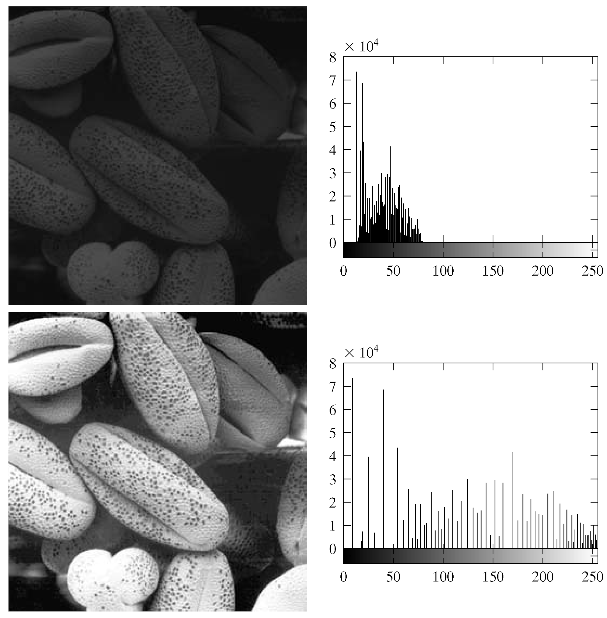
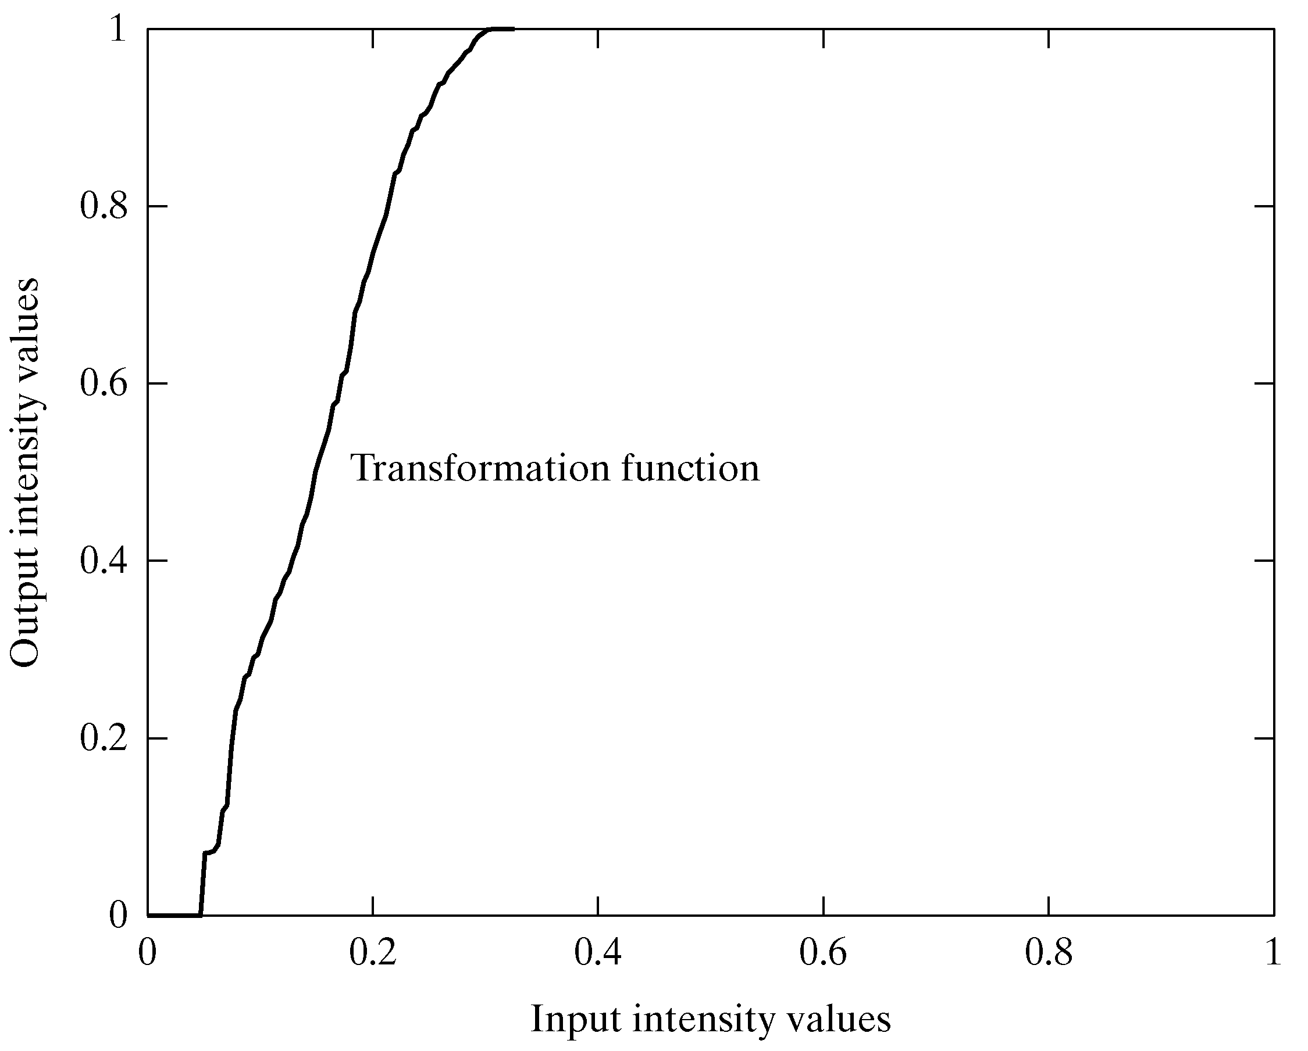
Equalisation Transformation Function

Slide 46
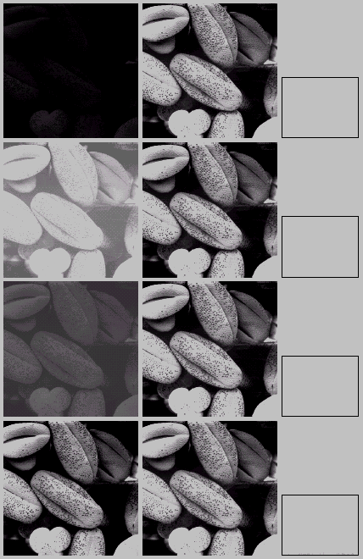
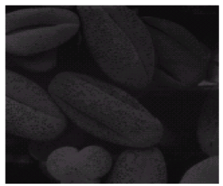
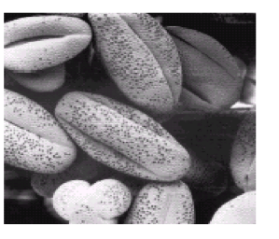

Slide 47
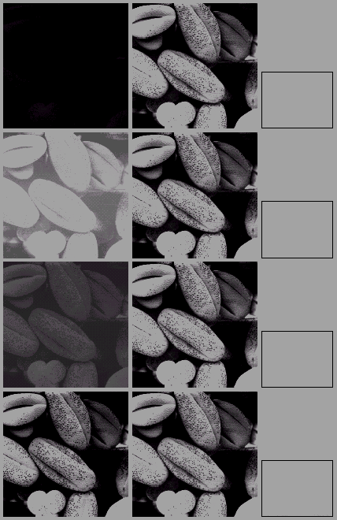
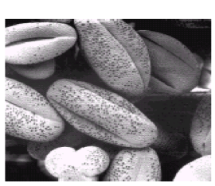
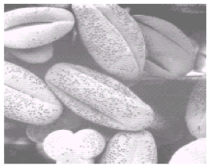

Slide 48
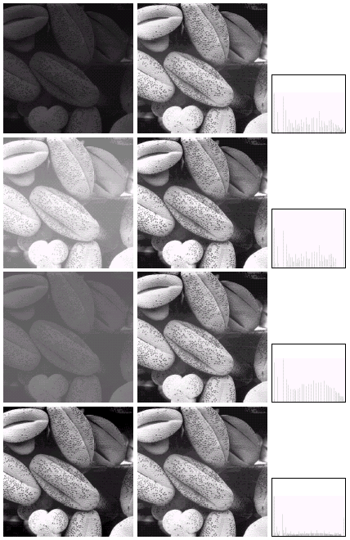
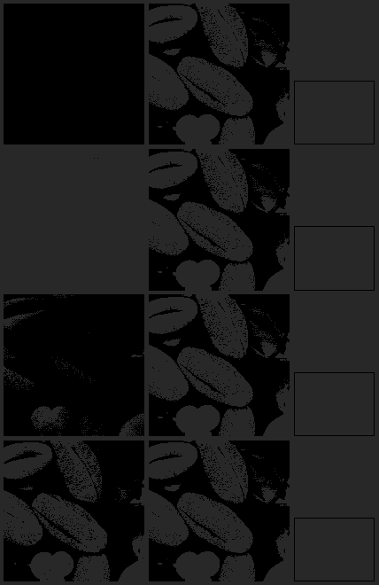
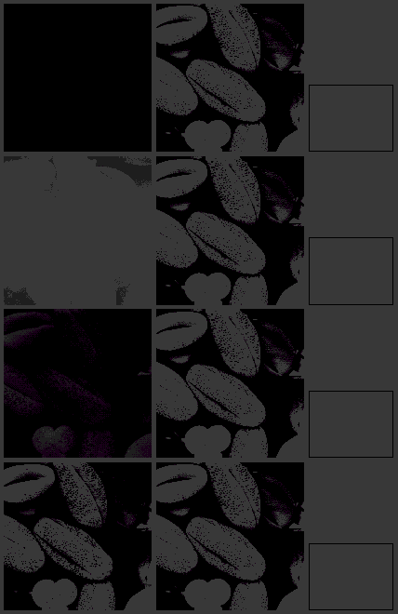

Slide 49
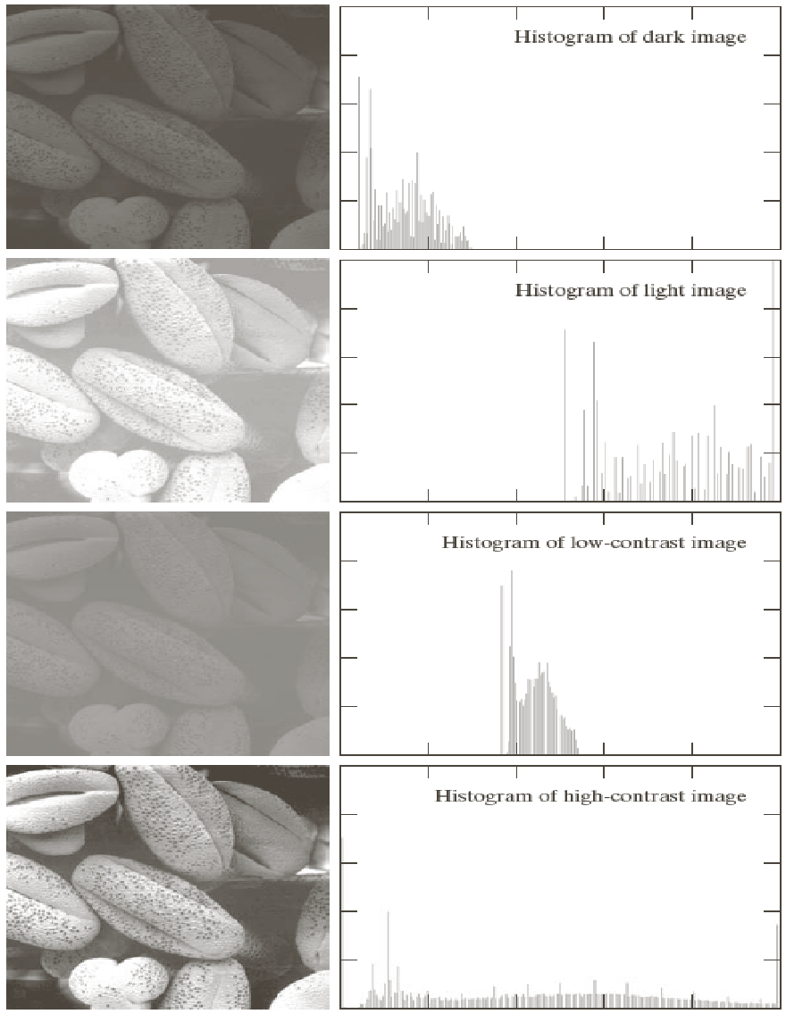
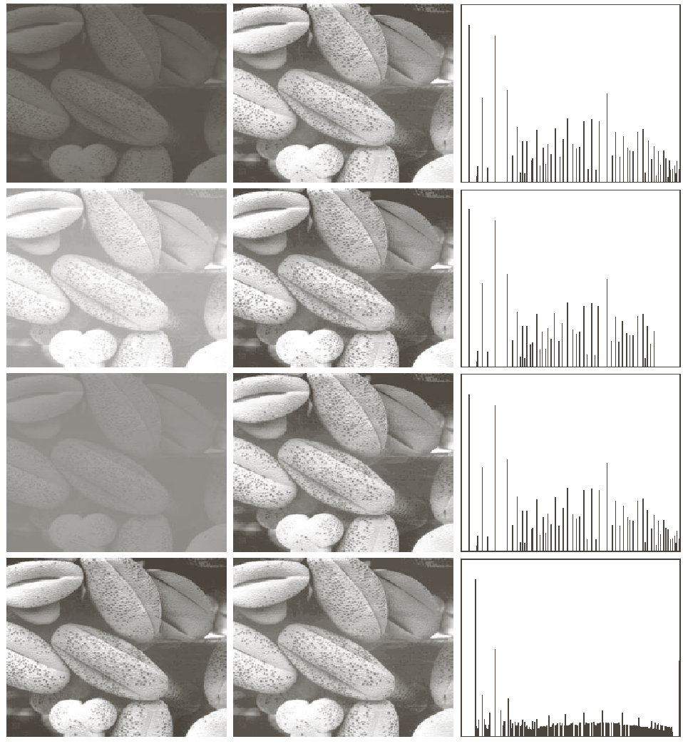


Slide 50
Input Image Histogram (A) :
Q(3) Input Image A is given below.
(a) Apply HE Tx
(b) Obtain Frequency Table of output Image B
(C) Plot Histogram of Input and Output image
Solution :
Gray Level r_{k} | 0 | 1 | 2 | 3 | 4 | 5 | 6 | 7
No of Pixels N_{rK} | 790 | 1023 | 850 | 656 | 329 | 245 | 122 | 81
‹#›
Kiran TALELE 99870 30 881 talelesir@gmail.com

Slide 51
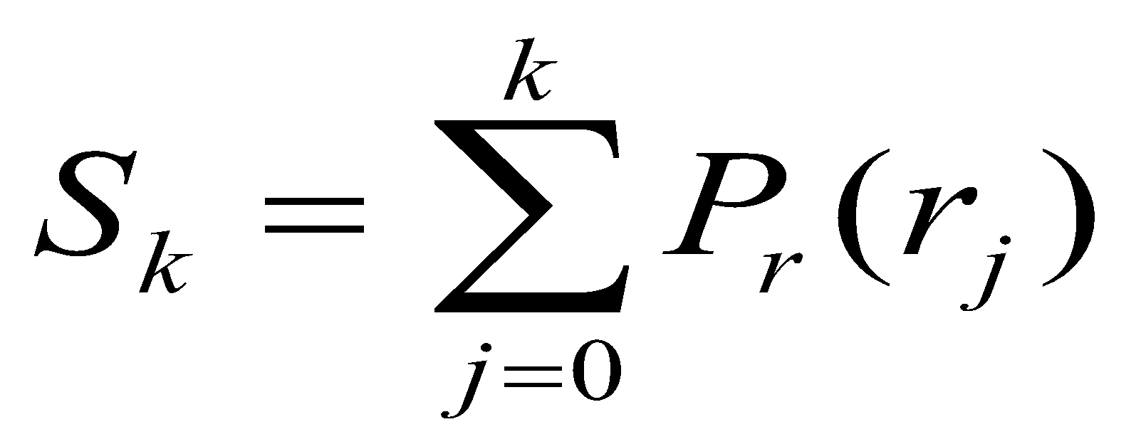
(a) Equalize Input Image Histogram A
r_{k}
s_{k}
Histogram Eualization S_{k} = T (r_{k})
‹#›
Kiran TALELE 99870 30 881 talelesir@gmail.com

Slide 52
INPUT rk | Norm rk | Freq. Nr_{k} | PDF Pr | CDF S_{k} | EqualizedGray Value S_{k}
0 | 0 | 790 | 0.192 | 0.192 | 1
1 | 1/7 | 1023 | 0.249 | 0.441 | 3
2 | 2/7 | 850 | 0.207 | 0.648 | 5
3 | 3/7 | 656 | 0.160 | 0.808 | 6
4 | 4/7 | 329 | 0.080 | 0.888 | 6
5 | 5/7 | 245 | 0.059 | 0.947 | 7
6 | 6/7 | 122 | 0.029 | 0.976 | 7
7 | 1 | 81 | 0.019 | 1 | 7
‹#›
Kiran TALELE 99870 30 881 talelesir@gmail.com

Slide 53
(b) Find Frequency Table of Output Image B
rk | Norm rk | Freq. Nr_{k} | PDF Pr | CDF S_{k} | S_{k}
0 | 0 | 790 | 0.192 | 0.192 | 1
1 | 1/7 | 1023 | 0.249 | 0.441 | 3
2 | 2/7 | 850 | 0.207 | 0.648 | 5
3 | 3/7 | 656 | 0.160 | 0.808 | 6
4 | 4/7 | 329 | 0.080 | 0.888 | 6
5 | 5/7 | 245 | 0.059 | 0.947 | 7
6 | 6/7 | 122 | 0.029 | 0.976 | 7
7 | 1 | 81 | 0.019 | 1 | 7
INPUT S_{k} | Freq NS_{k}
Frequency Table (B)
‹#›
Kiran TALELE 99870 30 881 talelesir@gmail.com

Slide 54
(b) Find Frequency Table of Output Image B
rk | Norm rk | Freq. Nr_{k} | PDF Pr | CDF S_{k} | S_{k}
0 | 0 | 790 | 0.192 | 0.192 | 1
1 | 1/7 | 1023 | 0.249 | 0.441 | 3
2 | 2/7 | 850 | 0.207 | 0.648 | 5
3 | 3/7 | 656 | 0.160 | 0.808 | 6
4 | 4/7 | 329 | 0.080 | 0.888 | 6
5 | 5/7 | 245 | 0.059 | 0.947 | 7
6 | 6/7 | 122 | 0.029 | 0.976 | 7
7 | 1 | 81 | 0.019 | 1 | 7
INPUT S_{k} | Freq NS_{k}
0
1
2
3
4
5
6
7
Frequency Table (B)
‹#›
Kiran TALELE 99870 30 881 talelesir@gmail.com

Slide 55
(b) Find Frequency Table of Output Image B
rk | Norm rk | Freq. Nr_{k} | PDF Pr | CDF S_{k} | S_{k}
0 | 0 | 790 | 0.192 | 0.192 | 1
1 | 1/7 | 1023 | 0.249 | 0.441 | 3
2 | 2/7 | 850 | 0.207 | 0.648 | 5
3 | 3/7 | 656 | 0.160 | 0.808 | 6
4 | 4/7 | 329 | 0.080 | 0.888 | 6
5 | 5/7 | 245 | 0.059 | 0.947 | 7
6 | 6/7 | 122 | 0.029 | 0.976 | 7
7 | 1 | 81 | 0.019 | 1 | 7
INPUT S_{k} | Freq NS_{k}
0 | 0
1
2 | 0
3
4 | 0
5
6
7
Frequency Table (B)

Slide 56
(b) Find Frequency Table of Output Image B
rk | Norm rk | Freq. Nr_{k} | PDF Pr | CDF S_{k} | S_{k}
0 | 0 | 790 | 0.192 | 0.192 | 1
1 | 1/7 | 1023 | 0.249 | 0.441 | 3
2 | 2/7 | 850 | 0.207 | 0.648 | 5
3 | 3/7 | 656 | 0.160 | 0.808 | 6
4 | 4/7 | 329 | 0.080 | 0.888 | 6
5 | 5/7 | 245 | 0.059 | 0.947 | 7
6 | 6/7 | 122 | 0.029 | 0.976 | 7
7 | 1 | 81 | 0.019 | 1 | 7
INPUT S_{k} | Freq NS_{k}
0 | 0
1 | 790
2 | 0
3
4 | 0
5
6
7
Frequency Table (B)

Slide 57
(b) Find Frequency Table of Output Image B
rk | Norm rk | Freq. Nr_{k} | PDF Pr | CDF S_{k} | S_{k}
0 | 0 | 790 | 0.192 | 0.192 | 1
1 | 1/7 | 1023 | 0.249 | 0.441 | 3
2 | 2/7 | 850 | 0.207 | 0.648 | 5
3 | 3/7 | 656 | 0.160 | 0.808 | 6
4 | 4/7 | 329 | 0.080 | 0.888 | 6
5 | 5/7 | 245 | 0.059 | 0.947 | 7
6 | 6/7 | 122 | 0.029 | 0.976 | 7
7 | 1 | 81 | 0.019 | 1 | 7
INPUT S_{k} | Freq NS_{k}
0 | 0
1 | 790
2 | 0
3 | 1023
4 | 0
5
6
7
‹#›
Kiran TALELE 99870 30 881 talelesir@gmail.com

Slide 58
(b) Find Frequency Table of Output Image B
rk | Norm rk | Freq. Nr_{k} | PDF Pr | CDF S_{k} | S_{k}
0 | 0 | 790 | 0.192 | 0.192 | 1
1 | 1/7 | 1023 | 0.249 | 0.441 | 3
2 | 2/7 | 850 | 0.207 | 0.648 | 5
3 | 3/7 | 656 | 0.160 | 0.808 | 6
4 | 4/7 | 329 | 0.080 | 0.888 | 6
5 | 5/7 | 245 | 0.059 | 0.947 | 7
6 | 6/7 | 122 | 0.029 | 0.976 | 7
7 | 1 | 81 | 0.019 | 1 | 7
INPUT S_{k} | Freq NS_{k}
0 | 0
1 | 790
2 | 0
3 | 1023
4 | 0
5 | 850
6 | 985
7 | 448
Frequency Table (B)

Slide 59
Input Histogram (A) and Equalized Histogram (B)
Input Histogram (A) :
Freq
1023
850
656
rk | Nr_{k}
0 | 790
1 | 1023
2 | 850
3 | 656
4 | 329
5 | 245
6 | 122
7 | 81
790
Sk | Ns_{k}
0 | 0
1 | 790
2 | 0
3 | 1023
4 | 0
5 | 850
6 | 985
7 | 448
329
245
122
81
r
0 1 2 3 4 5 6 7
Equalized Image Histogram (B)
Freq
1023
850
985
790
448
s
0 1 2 3 4 5 6 7

Slide 60
[2] Histogram Specification
(i) Histogram Specification Tx modifies histogram of input image as per the specified image histogram.
(ii) Histogram of the output image closely matches with the histogram of the specified image.
‹#›
Kiran TALELE 99870 30 881 talelesir@gmail.com

Slide 61
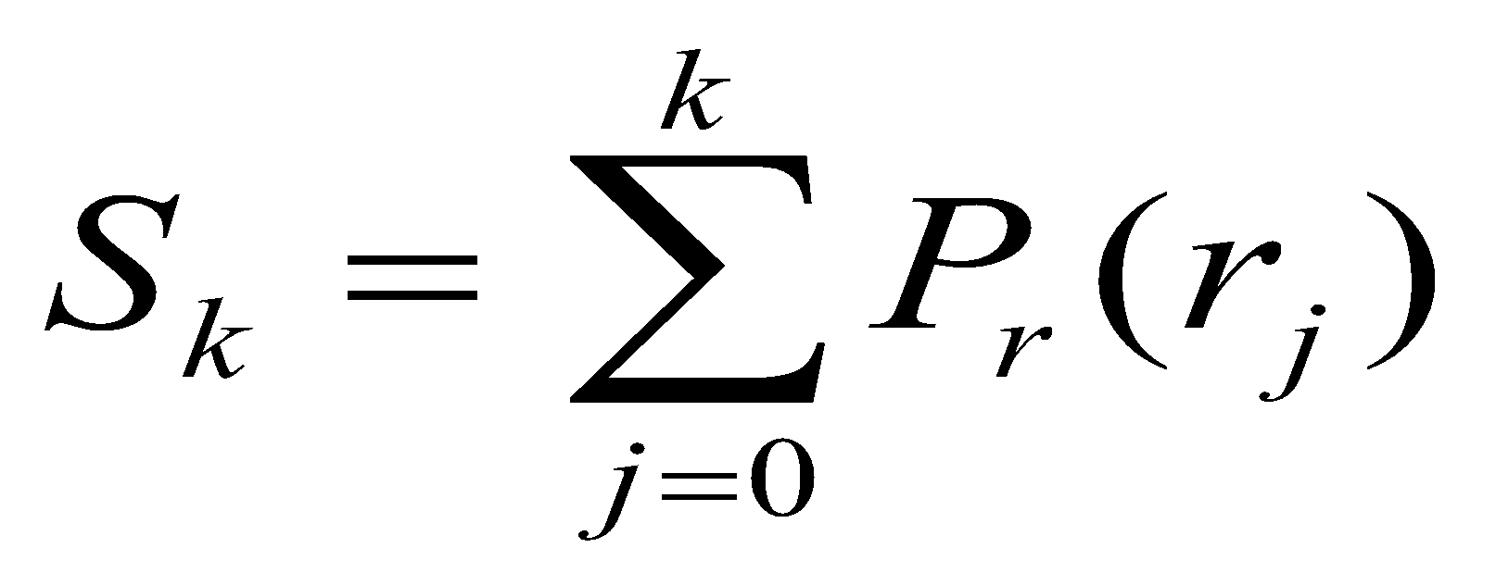
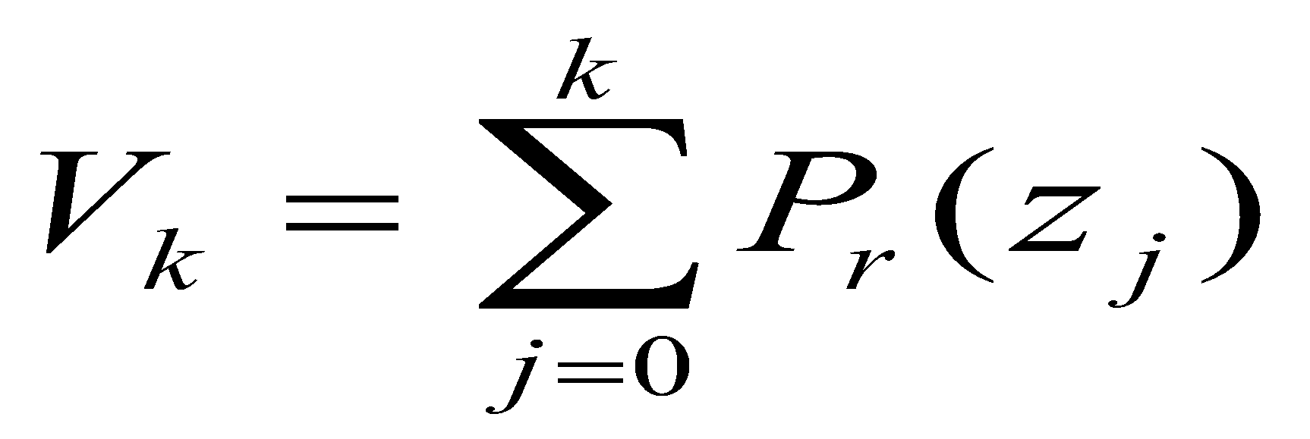
Histogram Specification Algorithm
(I) Equalize Histogram A
S_{k} = T ( r_{k} )
(II) Equalize Histogram B
v_{k} = T ( z_{k} )
‹#›
Kiran TALELE 99870 30 881 talelesir@gmail.com

Slide 62
Histogram Specification Algorithm…..
(III) Equalize Histogram A as per Histogram B
Express Z_{k} as a function of r_{k}
Z_{k} = G⁻¹ ( V_{k} )
Now, Equate S_{k} with V_{k}
Put V_{k} = Appropriate value of S_{k}
Z_{k} = G⁻¹ ( S_{k} )
Put S_{k} = T ( r_{k} )
Z_{k} = G⁻¹ [ T ( r_{k} ) ]
‹#›
Kiran TALELE 99870 30 881 talelesir@gmail.com

Slide 63
Q4
Histogram of Input Image A is given below.
(a) Modify the histogram A as given in
histogram B.
(b) Plot the histogram of the Input and Output Image.
‹#›
Kiran TALELE 99870 30 881 talelesir@gmail.com

Slide 64
Input Image Histogram (A) :
Gray Level r_{k} | 0 | 1 | 2 | 3 | 4 | 5 | 6 | 7
No of Pixels N_{rK} | 790 | 1023 | 850 | 656 | 329 | 245 | 122 | 81
Specified Histogram (B) :
Gray Level Z_{k} | 0 | 1 | 2 | 3 | 4 | 5 | 6 | 7
No of Pixels N_{ZK} | 0 | 0 | 0 | 614 | 819 | 1230 | 819 | 614
‹#›
Kiran TALELE 99870 30 881 talelesir@gmail.com

Slide 65
Step-1 : Equalize Input Image Histogram A
r_{k}
s_{k}
Histogram Eualization S_{k} = T (r_{k})
‹#›
Kiran TALELE 99870 30 881 talelesir@gmail.com

Slide 66
INPUT rk | Norm rk | Freq. Nr_{k} | PDF Pr | CDF S_{k} | EqualizedGray Value S_{k}
0 | 0 | 790 | 0.192 | 0.192 | 1
1 | 1/7 | 1023 | 0.249 | 0.441 | 3
2 | 2/7 | 850 | 0.207 | 0.648 | 5
3 | 3/7 | 656 | 0.160 | 0.808 | 6
4 | 4/7 | 329 | 0.080 | 0.888 | 6
5 | 5/7 | 245 | 0.059 | 0.947 | 7
6 | 6/7 | 122 | 0.029 | 0.976 | 7
7 | 1 | 81 | 0.019 | 1 | 7
‹#›
Kiran TALELE 99870 30 881 talelesir@gmail.com

Slide 67
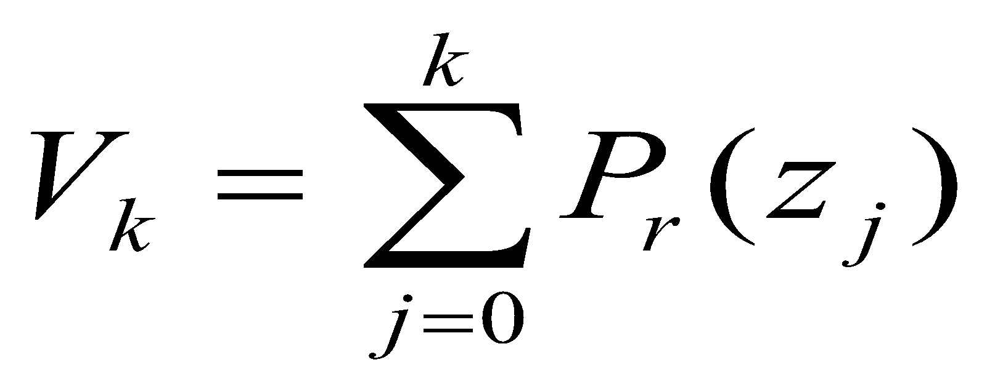
Step-2 : Equalize Specified Histogram B
z_{k}
v_{k}
Histogram Eualization V_{k} = G ( Zk )
‹#›
Kiran TALELE 99870 30 881 talelesir@gmail.com

Slide 68
INPUT Zk | Norm Zk | Freq. Nz_{k} | PDF Pr | CDF V_{k} | EqualizedV_{k}
0 | 0 | 0
1 | 1/7 | 0
2 | 2/7 | 0
3 | 3/7 | 614
4 | 4/7 | 819
5 | 5/7 | 1230
6 | 6/7 | 819
7 | 1 | 614
‹#›
Kiran TALELE 99870 30 881 talelesir@gmail.com

Slide 69
INPUT Zk | Norm Zk | Freq. Nz_{k} | PDF Pr | CDF V_{k} | Denorm. V_{k}
0 | 0 | 0 | 0
1 | 1/7 | 0 | 0
2 | 2/7 | 0 | 0
3 | 3/7 | 614 | 0.150
4 | 4/7 | 819 | 0.200
5 | 5/7 | 1230 | 0.300
6 | 6/7 | 819 | 0.200
7 | 1 | 614 | 0.150
‹#›
Kiran TALELE 99870 30 881 talelesir@gmail.com

Slide 70
INPUT Zk | Norm Zk | Freq. Nz_{k} | PDF Pr | CDF V_{k} | Denorm. V_{k}
0 | 0 | 0 | 0 | 0
1 | 1/7 | 0 | 0 | 0
2 | 2/7 | 0 | 0 | 0
3 | 3/7 | 614 | 0.150 | 0.150
4 | 4/7 | 819 | 0.200 | 0.350
5 | 5/7 | 1230 | 0.300 | 0.650
6 | 6/7 | 819 | 0.200 | 0.850
7 | 1 | 614 | 0.150 | 1.00
‹#›
Kiran TALELE 99870 30 881 talelesir@gmail.com

Slide 71
INPUT Zk | Norm Zk | Freq. Nz_{k} | PDF Pr | CDF V_{k} | EqualizedV_{k}
0 | 0 | 0 | 0 | 0 | 0
1 | 1/7 | 0 | 0 | 0 | 0
2 | 2/7 | 0 | 0 | 0 | 0
3 | 3/7 | 614 | 0.150 | 0.150 | 1
4 | 4/7 | 819 | 0.200 | 0.350 | 2
5 | 5/7 | 1230 | 0.300 | 0.650 | 5
6 | 6/7 | 819 | 0.200 | 0.850 | 6
7 | 1 | 614 | 0.150 | 1.00 | 7
‹#›
Kiran TALELE 99870 30 881 talelesir@gmail.com

Slide 72
Step-3 : Equalize Histogram A as per Histogram B
Express Z_{k} as a function of r_{k}
Z_{k} = G⁻¹ [ T ( r_{k} ) ]
Col 1
Col 2
Col 3
Col 4
Col 5
INPUT rk | Equalized Sk | Closest V_{k} | Inverse Z_{k} | Freq. of Z_{k} In the output Image N_{k}
0
1
2
3 , 4
5, 6, 7
‹#›
Kiran TALELE 99870 30 881 talelesir@gmail.com

Slide 73
Histogram A Equalization Result
Step-3 : Column 2
INPUT rk | Equalized Gray Value S_{k}
0 | 1
1 | 3
2 | 5
3 | 6
4 | 6
5 | 7
6 | 7
7 | 7
Col 1
Col 2
INPUT rk | Equalized Sk
0 | 1
1 | 3
2 | 5
3 , 4 | 6
5, 6, 7 | 7
‹#›
Kiran TALELE 99870 30 881 talelesir@gmail.com

Slide 74
Step-1 : Result
Step-2 : Result
Step-3 : Find Column 3
rk | S_{k}
0 | 1
1 | 3
2 | 5
3 | 6
4 | 6
5 | 7
6 | 7
7 | 7
Zk | V_{k}
0 | 0
1 | 0
2 | 0
3 | 1
4 | 2
5 | 5
6 | 6
7 | 7
Col 2
Col 3
Equalized Sk | Closest Vk
1 | 1
3 | 2
5 | 5
6 | 6
7 | 7
‹#›
Kiran TALELE 99870 30 881 talelesir@gmail.com

Slide 75
Step-1 : Result
Step-2 : Result
Step-3 : Find Column 4
rk | S_{k}
0 | 1
1 | 3
2 | 5
3 | 6
4 | 6
5 | 7
6 | 7
7 | 7
Zk | V_{k}
0 | 0
1 | 0
2 | 0
3 | 1
4 | 2
5 | 5
6 | 6
7 | 7
Col 3
Col 4
Closest Vk | Inverse Zk
1 | 3
2 | 4
5 | 5
6 | 6
7 | 7
‹#›
Kiran TALELE 99870 30 881 talelesir@gmail.com

Slide 76
Step-1 : Result
Step-2 : Result
Step-3 : Find Column 5
Col 4
Col 5
rk | S_{k}
0 | 1
1 | 3
2 | 5
3 | 6
4 | 6
5 | 7
6 | 7
7 | 7
Zk | V_{k}
0 | 0
1 | 0
2 | 0
3 | 1
4 | 2
5 | 5
6 | 6
7 | 7
Inverse Zk | Freq Nk
3 | 790
4 | 1023
5 | 850
6 | 656+329 = 985
7 | 245+122+81 = 448
‹#›
Kiran TALELE 99870 30 881 talelesir@gmail.com

Slide 77
Step-3 : Equalize Histogram A as per Histogram B
Express Z_{k} as a function of r_{k}
Z_{k} = G⁻¹ [ T ( r_{k} ) ]
Col 1
Col 2
Col 3
Col 4
Col 5
INPUT rk | Equalized Sk | Closest V_{k} | Inverse Z_{k} | Freq. of Z_{k} In the output Image N_{k}
0 | 1 | 1 | 3 | 790
1 | 3 | 2 | 4 | 1023
2 | 5 | 5 | 5 | 850
3 , 4 | 6 | 6 | 6 | 985
5, 6, 7 | 7 | 7 | 7 | 448
‹#›
Kiran TALELE 99870 30 881 talelesir@gmail.com

Slide 78
Step-4 : Find Frequency Table of Output Image
Output Image Gray Value : Z_{k} | Freq. of Z_{k} In the output Image N_{k}
0 | 0
1 | 0
2 | 0
3 | 790
4 | 1023
5 | 850
6 | 985
7 | 448
‹#›
Kiran TALELE 99870 30 881 talelesir@gmail.com

Slide 79
Input Histogram (A) and Equalized Histogram
Input Histogram (A) :
Freq
1023
850
656
rk | Nr_{k}
0 | 790
1 | 1023
2 | 850
3 | 656
4 | 329
5 | 245
6 | 122
7 | 81
790
Sk | Ns_{k}
0 | 0
1 | 790
2 | 0
3 | 1023
4 | 0
5 | 850
6 | 985
7 | 448
329
245
122
81
r
0 1 2 3 4 5 6 7
Equalized Input Histogram (A)
Freq
1023
850
985
790
448
s
0 1 2 3 4 5 6 7

Slide 80
Specified Histogram (B) & Equalized Histogram
Specified Histogram (B) :
Freq
1230
819
819
Zk | Nz_{k}
0 | 0
1 | 0
2 | 0
3 | 614
4 | 819
5 | 1230
6 | 819
7 | 614
Vk | Nv_{k}
0 | 0
1 | 614
2 | 819
3 | 0
4 | 0
5 | 1230
6 | 819
7 | 614
614
614
r
0 1 2 3 4 5 6 7
Equalized Histogram (B) :
Freq
1230
819
819
614
614
s
0 1 2 3 4 5 6 7

Slide 81
Input Histogram (A) and Equalized Histogram as per B
Input Histogram (A) :
Freq
1023
850
656
rk | Nr_{k}
0 | 790
1 | 1023
2 | 850
3 | 656
4 | 329
5 | 245
6 | 122
7 | 81
790
Zk | Nz_{k}
0 | 0
1 | 0
2 | 0
3 | 790
4 | 1023
5 | 850
6 | 985
7 | 448
329
245
122
81
r
0 1 2 3 4 5 6 7
Equalized Input Histogram as per (B)
Freq
1023
985
850
790
448
s
0 1 2 3 4 5 6 7

Slide 82
Input Histogram (A) :
Equalized Input Histogram (A)
Freq
1023
Freq
1023
850
850
985
790
656
790
329
448
245
122
81
r
s
0 1 2 3 4 5 6 7
0 1 2 3 4 5 6 7
Specified Histogram (B) :
Equalized Histogram(A) as per (B)
Freq
1230
Freq
1023
985
819
819
850
790
614
614
448
r
s
0 1 2 3 4 5 6 7
0 1 2 3 4 5 6 7

Slide 83
[3] Histogram Stretching
Histogram Stretching Tx increases the dynamic range of Gray values of input image linearly.
‹#›
Kiran TALELE 99870 30 881 talelesir@gmail.com

Slide 84
Q5 Frequency table of 3 bit input image is given below. Increase the dynamic range to [0 to 7] and find new image frequency table.
Gray Level r_{k} | 0 | 1 | 2 | 3 | 4 | 5 | 6 | 7
Frequency N_{rk} | 100 | 90 | 85 | 70 | 0 | 0 | 0 | 0
‹#›
Kiran TALELE 99870 30 881 talelesir@gmail.com

Slide 85
[4] Local Histogram Equalization
Local HE is done by applying Transformation function over the intensity distribution in neighborhood of every pixel
At each pixel, Histogram of the points in the neighbourhood is computed and either Histogram equalization or Histogram Specification is either obtained
‹#›
Kiran TALELE 99870 30 881 talelesir@gmail.com

Slide 86
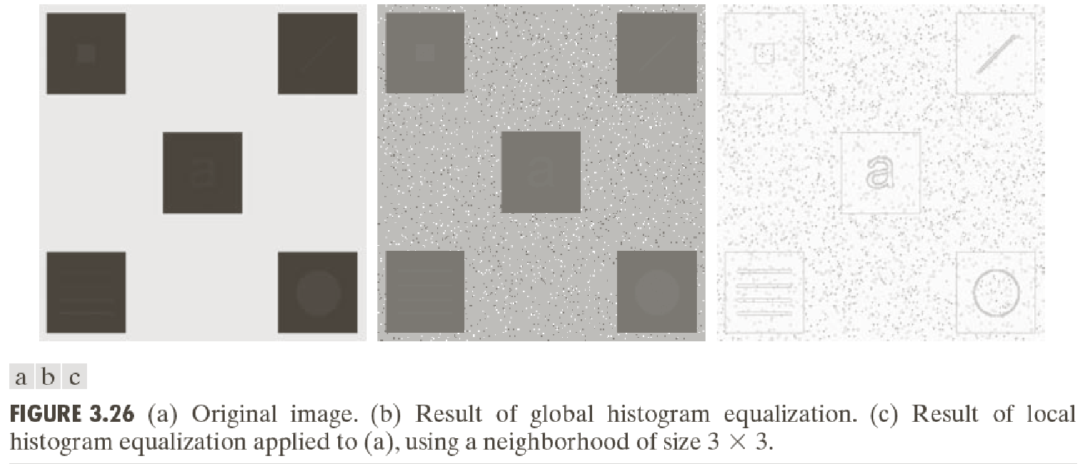
Local Histogram Processing….
(a) Original Image (b) Result of Global HE (c) Result of Local HE
Image in (a) is slightly noisy but the noise is imperceptible.
HE enhances the noise in smooth regions (b).
Local HE reveals structures having values close to the values of the squares and small sizes to influence HE (c).

Slide 87
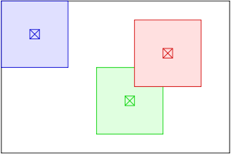
[4] Adaptive Histogram Equalization (AHE)
The adaptive method computes several histograms, each corresponding to a distinct section of the image, and uses them to redistribute the lightness values of the image.
It is therefore suitable for improving the local contrast and enhancing the definitions of edges in each region of an image.
‹#›
Kiran TALELE 99870 30 881 talelesir@gmail.com

Slide 88
[6] Contrast Limited Adaptive Histogram Equalization (CLAHE)
CLAHE is a variation of Adaptive histogram equalization (AHE) that prevents contrast over-amplification.
The input image is first divided into sections. Each section is called a tile. The input image is divided into four tiles. Histogram equalization is then performed on each tile using a pre-defined clip limit.
‹#›
Kiran TALELE 99870 30 881 talelesir@gmail.com

Slide 89
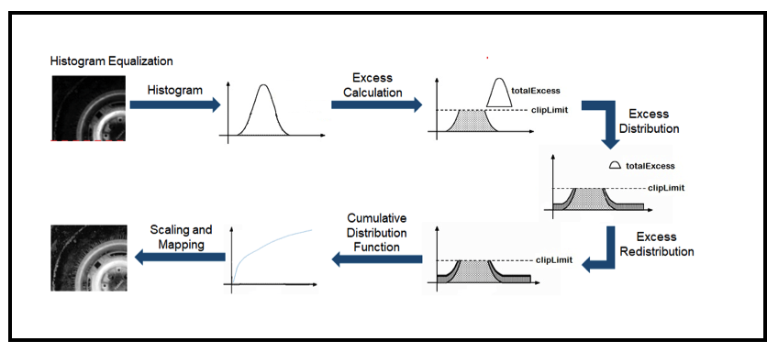
Histogram equalization is then performed on each tile using a pre-defined clip limit.
‹#›
Kiran TALELE 99870 30 881 talelesir@gmail.com

Slide 90
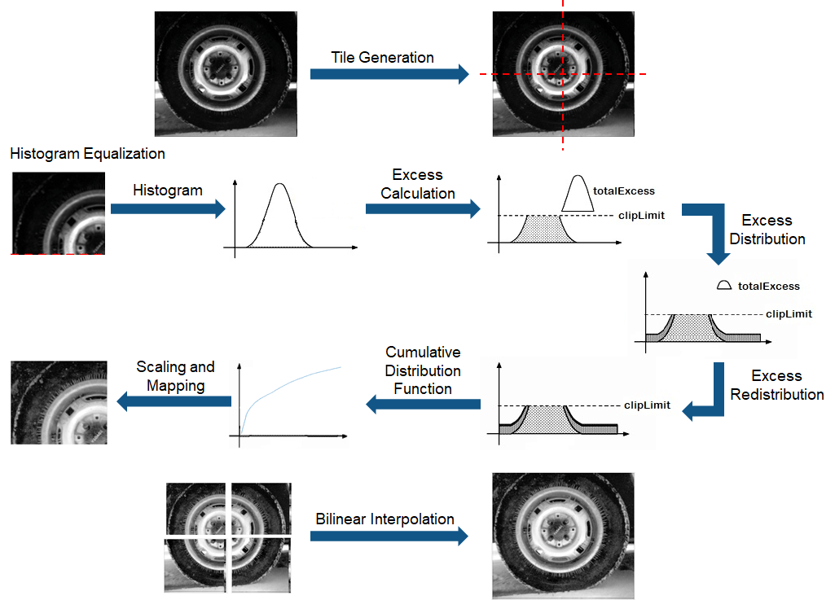

Slide 91
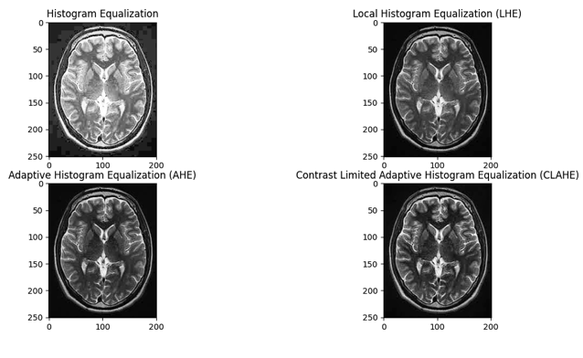
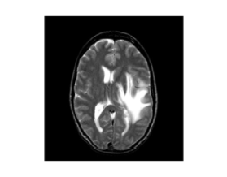
Results of HE, Local HE, AHE and CLAHE:
Original Image
Result of Global HE
Result of AHE
Result of CLAHE
‹#›
Kiran TALELE 99870 30 881 talelesir@gmail.com

Slide 92
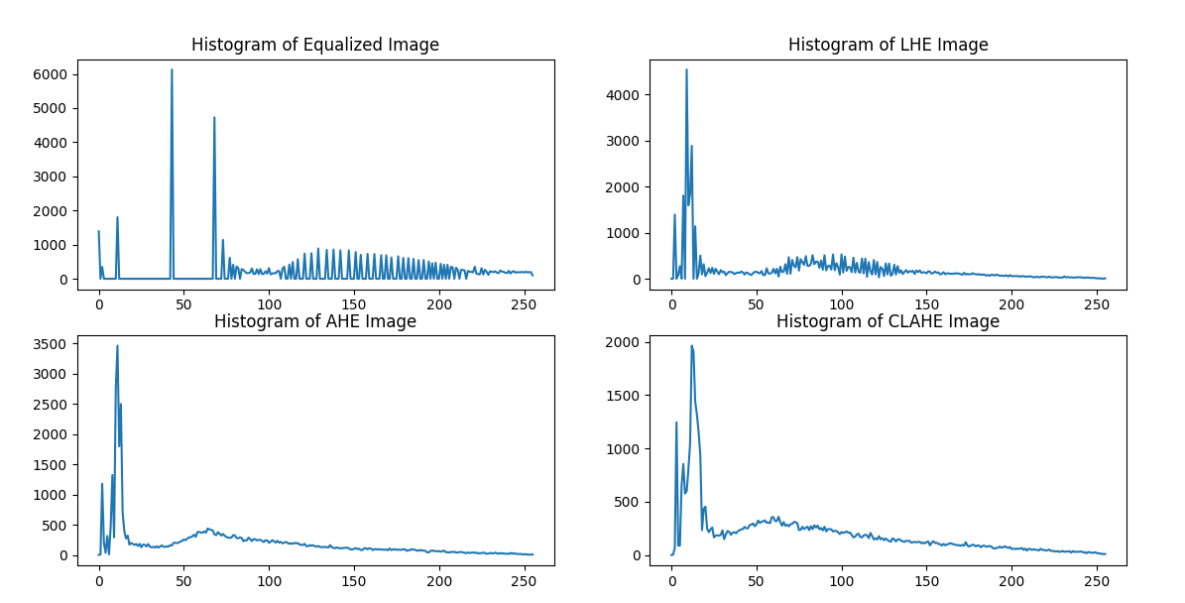
Histogram of Original Image
Histogram of Global HE
Histogram of AHE
Histogram of CLAHE
‹#›
Kiran TALELE 99870 30 881 talelesir@gmail.com

Slide 93
[7] Gray Level Grouping (GLG)
. Group the histogram components into a proper number of gray-level bins according to their amplitudes
This creates empty gray levels on the grayscale
Redistribute these groups of histogram components uni­formly over the grayscale.
The concentrated histogram components spread out and image contrast is increased.
The grayscale is utilized efficiently
Over-contrast problem is also avoided.
Kiran TALELE
‹#›

Slide 94
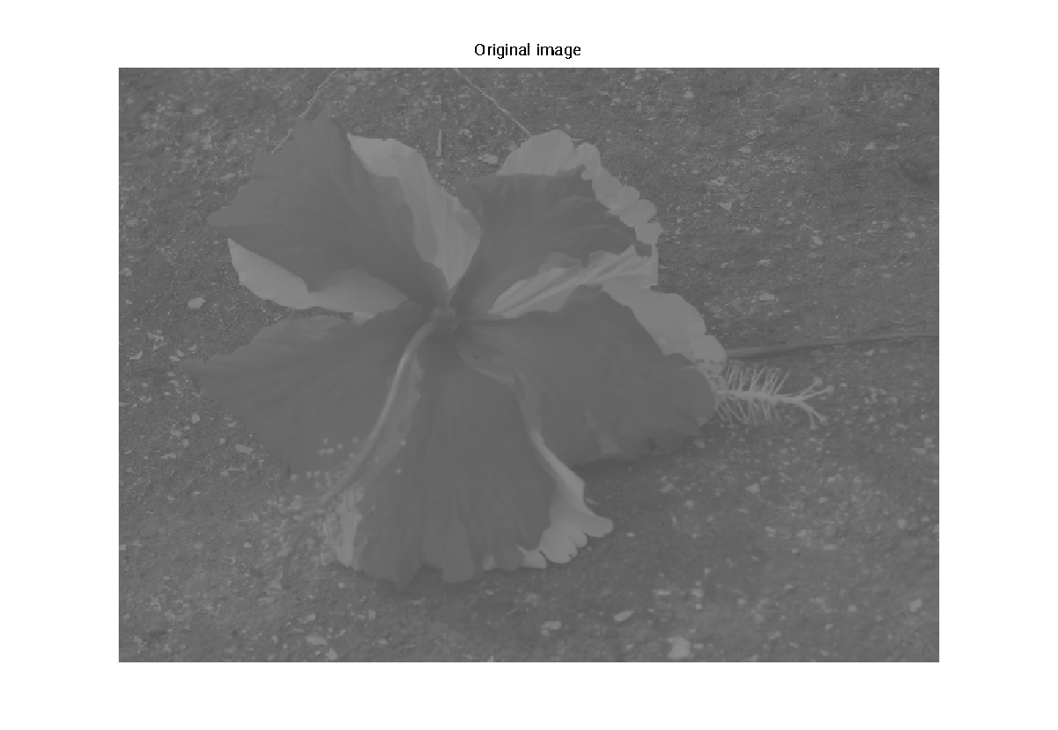
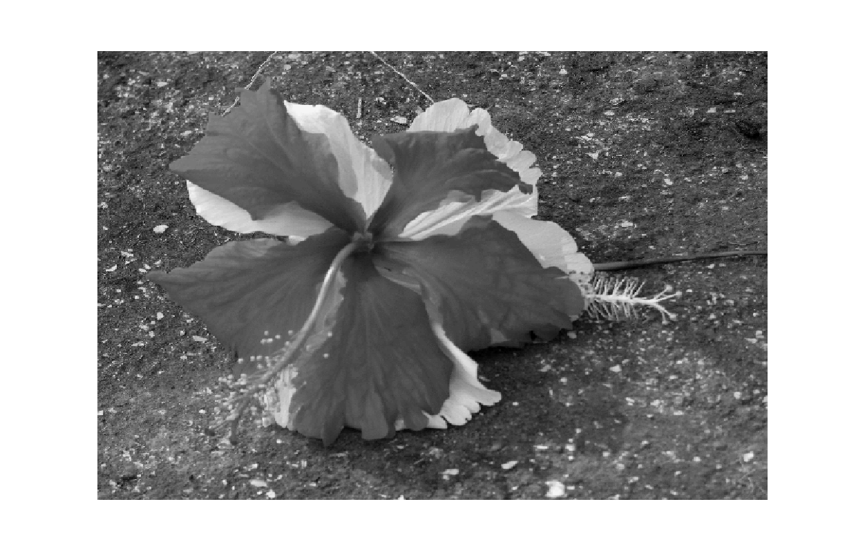
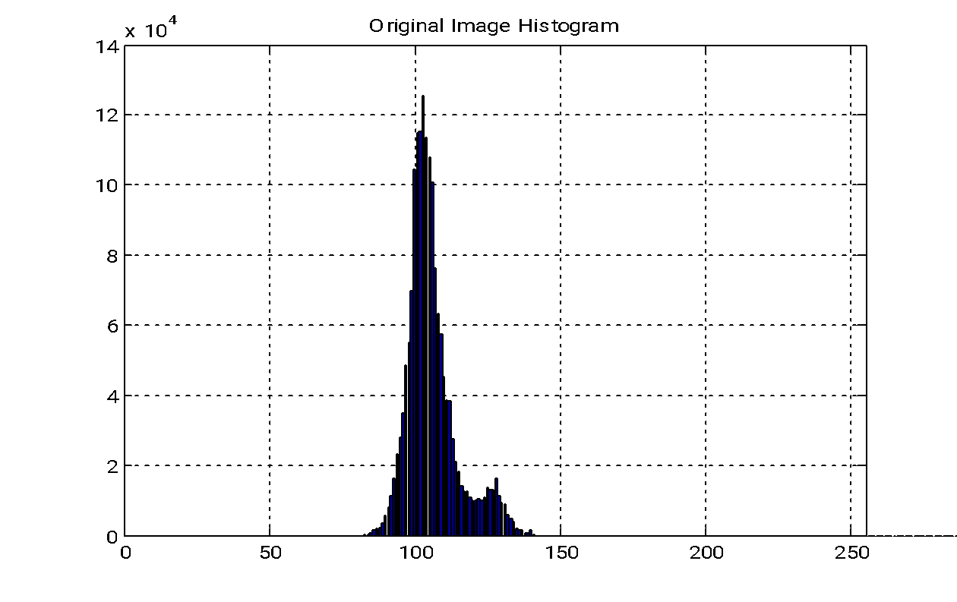
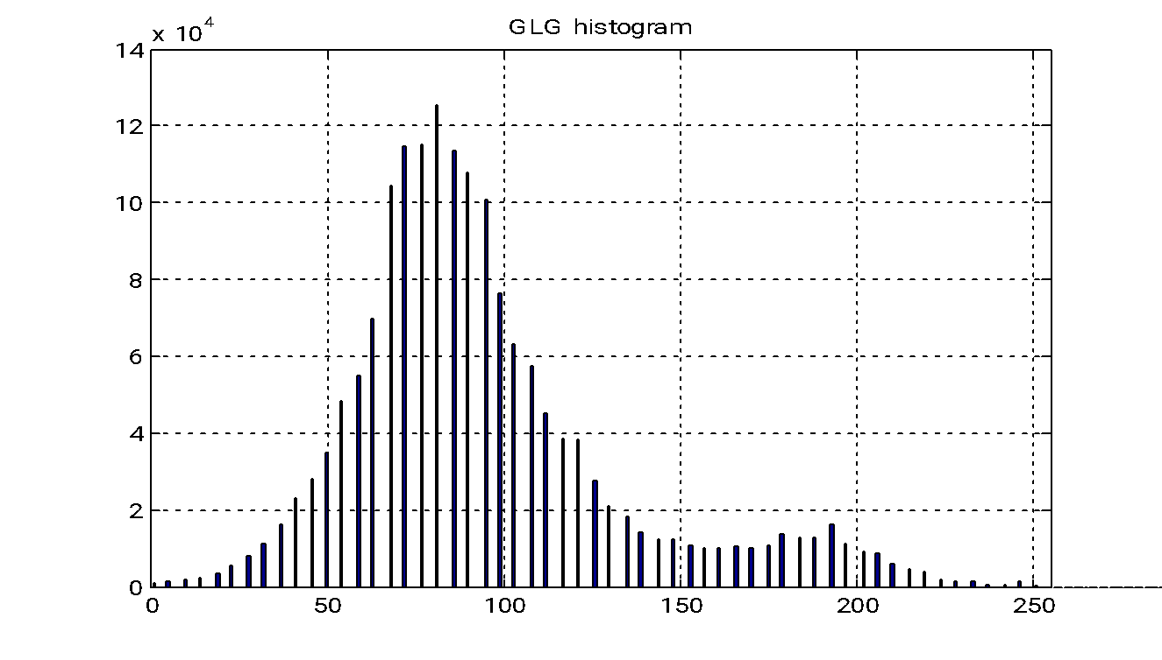
Gray Level Grouping (GLG)….
Original Image
GLG Image
Original Image Histogram
GLGl Image Histogram
Kiran TALELE
‹#›

Slide 95
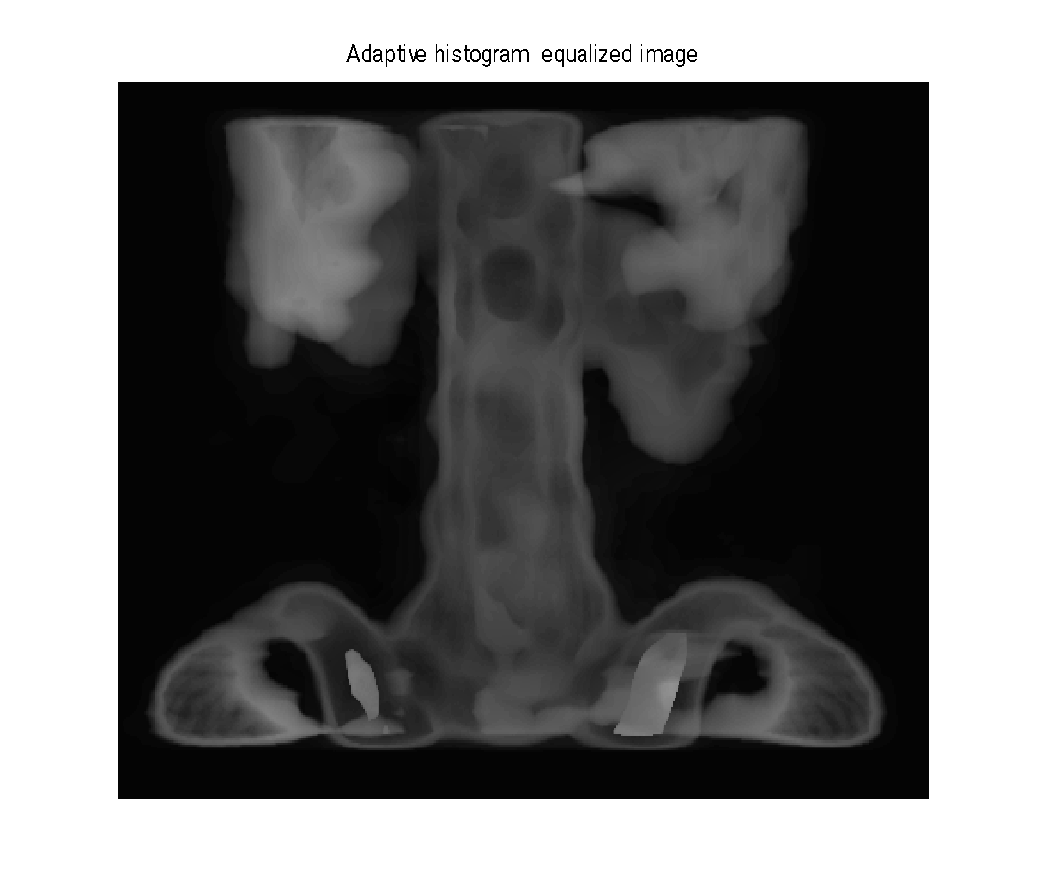
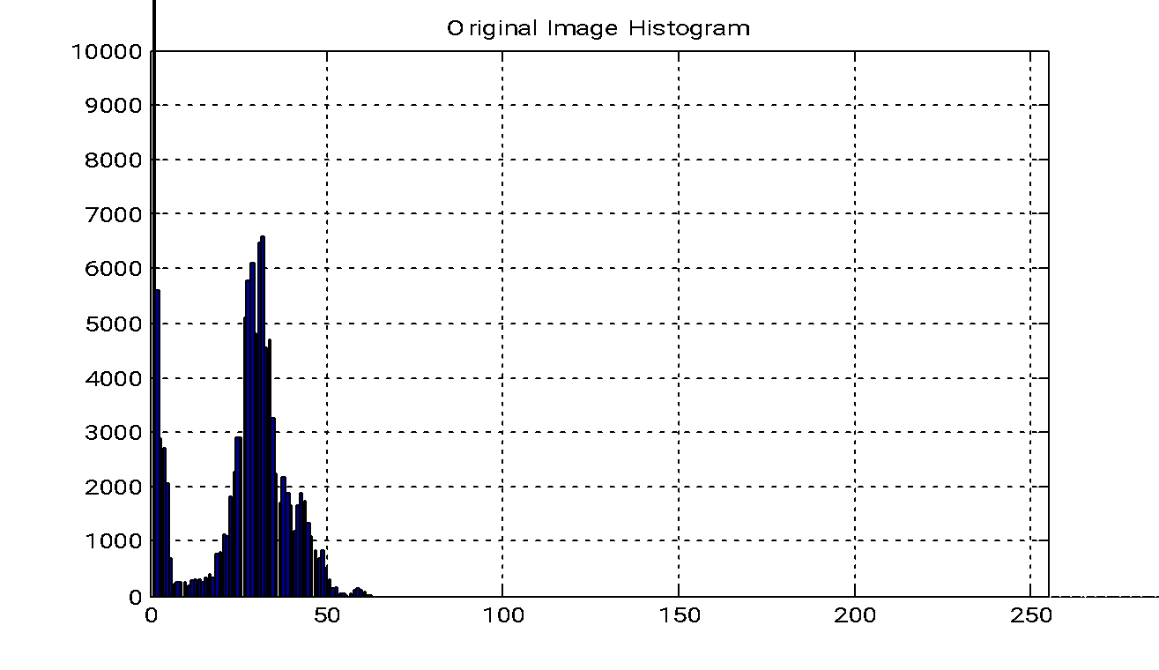
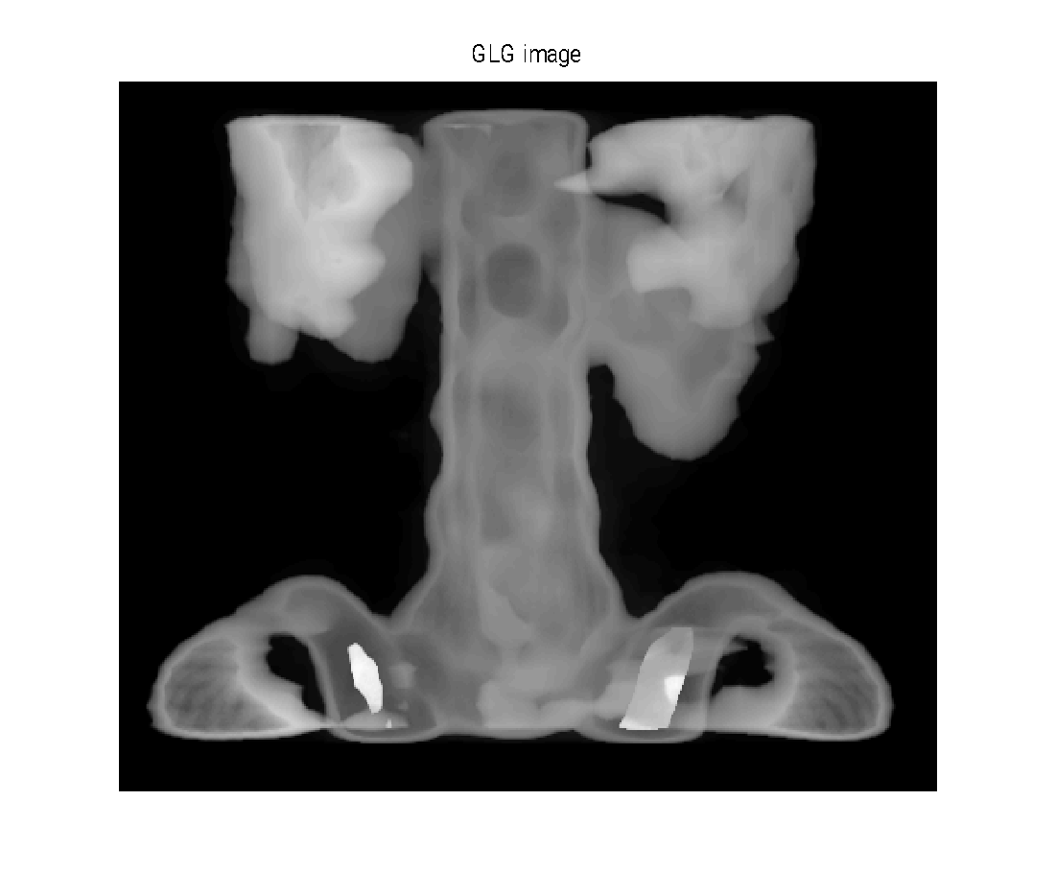
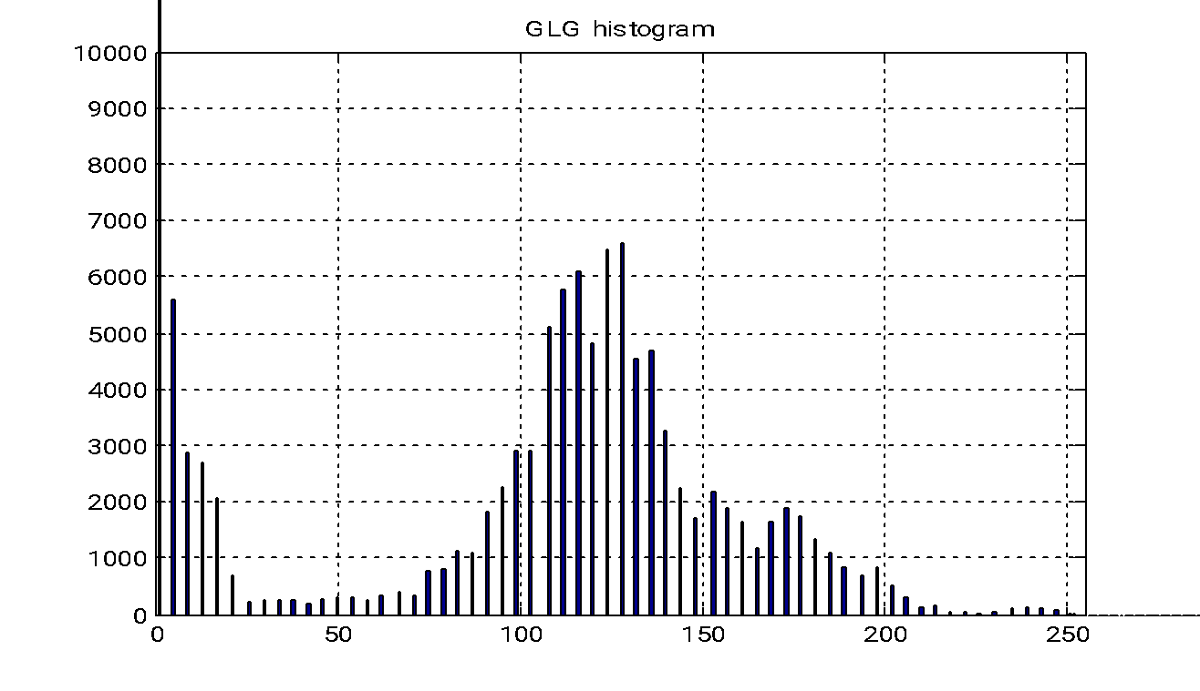
Original Image
Original Image Histogram
GLG Image
GLG Image Histogram
Kiran TALELE
‹#›

Slide 96
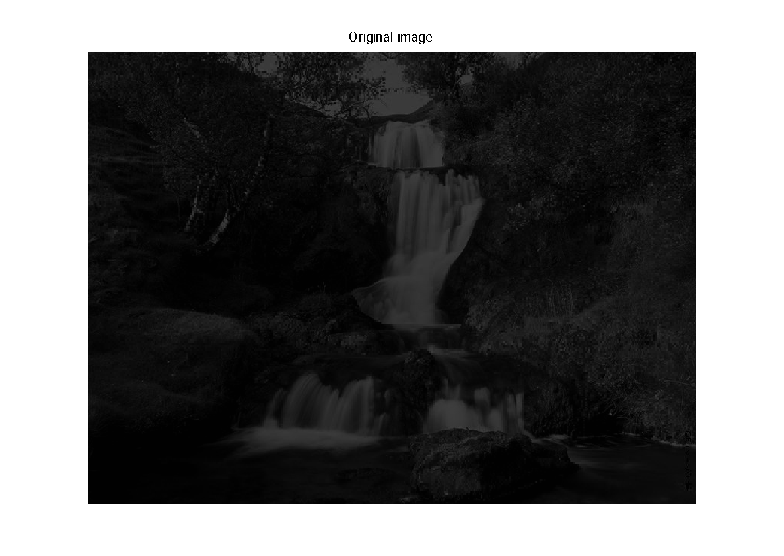



Original Image
GLG Image
Original Image Histogram
GLG Image Histogram
Kiran TALELE
‹#›

Slide 97




Original Image
Result of Global HE
Result of AHE
Result of GLG
Kiran TALELE
‹#›

Slide 98




Original Image
Result of Global HE
Result of AHE
Result of GLG

Slide 99




Dr. Kiran TALELE
Academic : PhD
Professional :
Dean-Students, Alumni & External Relations @ Bharatiya Vidya Bhavans’ Sardar Patel Institute of Technology (SP-IT), Mumbai
Head-Academic Relation @ Sardar Patel Technology Business Incubator (SP-TBI), Mumbai
Treasurer-IEEE Bombay Section
091-9987030881
kiran.talele@spit.ac.in / ktvtalele@gmail.com
https://www.linkedin.com/in/k-t-v-talele/
www.facebook.com/Kiran-Talele-1711929555720263
Stay Connected
‹#›
‹#›

Slide 100
Dr. Kiran TALELE is an Associate Professor in Electronics & Telecommunication Engineering Department of Bharatiya Vidya Bhavans’ Sardar Patel Institute of Technology, Mumbai with 33+ years experience in Academics.
He is a Dean of Students, Alumni and External Relations at Sardar Patel Institute of Technology, Andheri Mumbai.
He is also a Head of Sardar Patel Technology Business Incubator, Mumbai.
His area of research is Digital Signal & Image Processing, Computer Vision, Machine Learning and Multimedia System Design.
He has published 85+ research papers at various national & international refereed conferences and journals. He has filed published 25+ patents at Indian Patent Office. One patent is granted in 2021.
He is a Treasurer of IEEE Bombay Section and Mentor for Startup Incubation & Intellectual Asset Creation.
He is a recipient of P.R. Bapat IEEE Bombay Section Outstanding Volunteer Award 2019.

